Slide 1
Collection Week 4

Slide 2
On Gathering
Why gather
How to gather
Ways to do it

Slide 3
Why Gather?
Notes:
Ask them

Slide 4
Why Gather?
Not being done!
Make the world better
Make something you care about last
Because otherwise someone else will do it instead/in spite of you

Slide 5
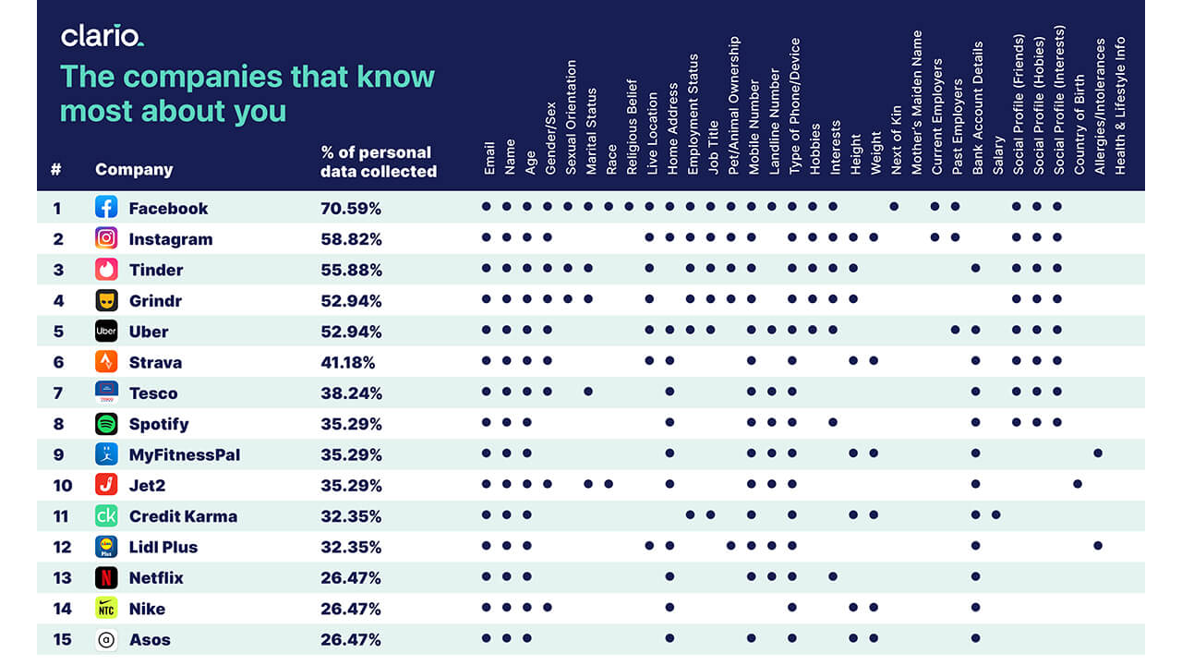
How to Gather – Passively

Slide 6
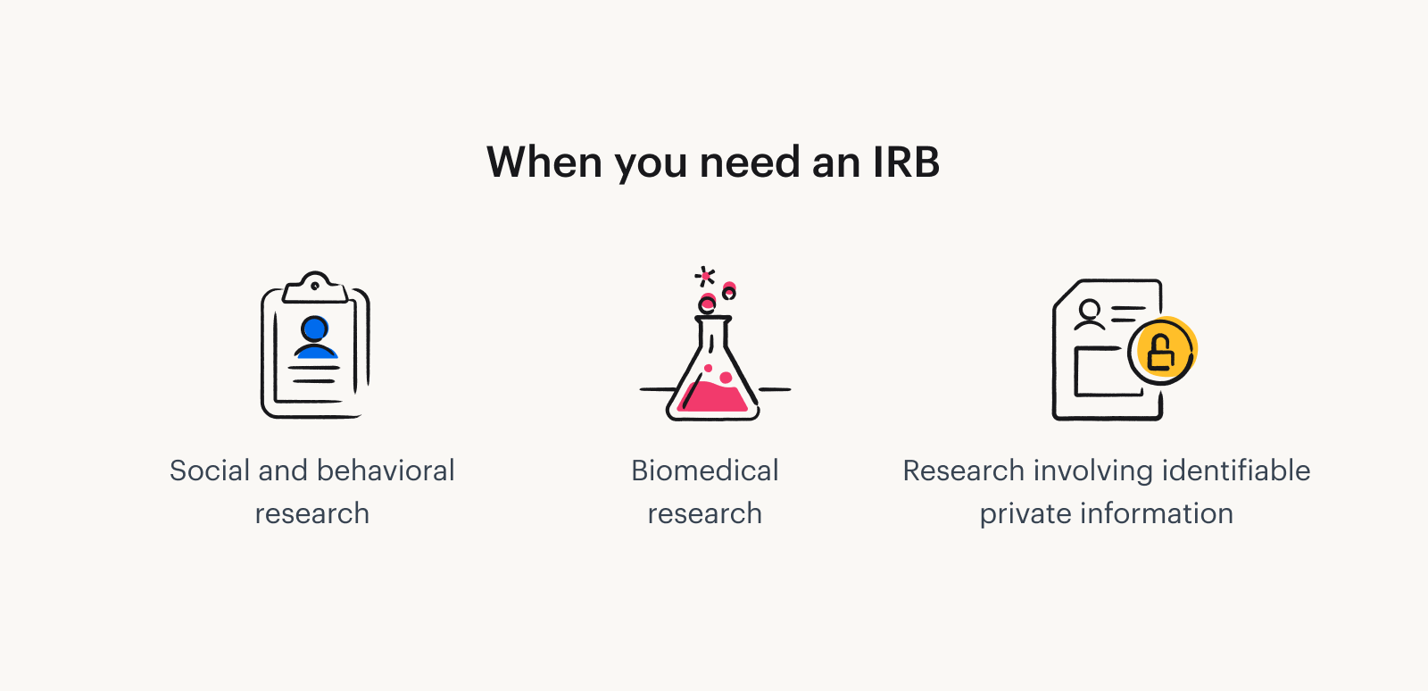

How to Gather - Ethics
Notes:
https://www.tremendous.com/blog/
https://www.google.com/imgres?q=irb&imgurl=https%3A%2F%2Fwww.nsula.edu%2Fwp-content%2Fuploads%2FScreen-Shot-2022-09-01-at-11.16.17-AM.png&imgrefurl=https%3A%2F%2Fwww.nsula.edu%2Fnsu-irb-announces-changes-updates%2F&docid=ktE_eJUmjLq1NM&tbnid=1F-_7zA2Um8I6M&vet=12ahUKEwiMjsD4lKOKAxUYMVkFHWdrBKcQM3oECBgQAA..i&w=4014&h=1688&hcb=2&ved=2ahUKEwiMjsD4lKOKAxUYMVkFHWdrBKcQM3oECBgQAAwhat-is-an-irb-and-what-purpose-does-it-serve/

Slide 7
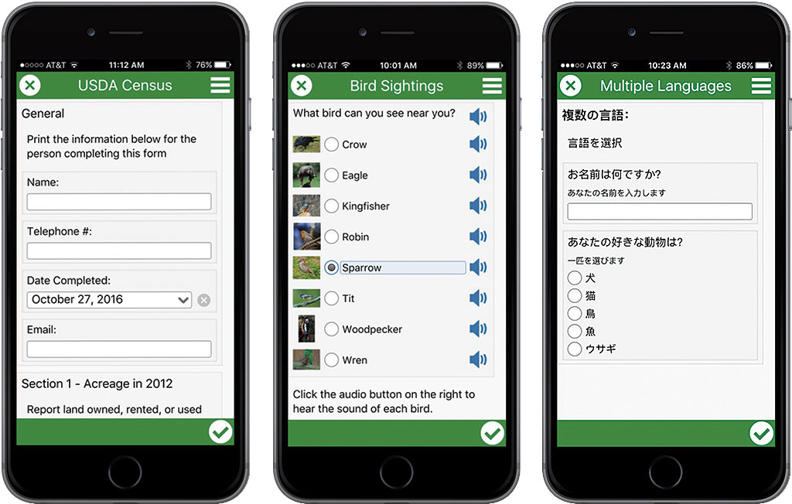
Ways to Gather - Individually
Survey 123 (at right)
Google forms
Can pull directly into spreadsheet
Direct interviews
Best practice is to compensate subjects
Notes:
https://www.esri.com/about/newsroom/arcuser/5-reasons-to-use-survey123-for-arcgis/

Slide 8
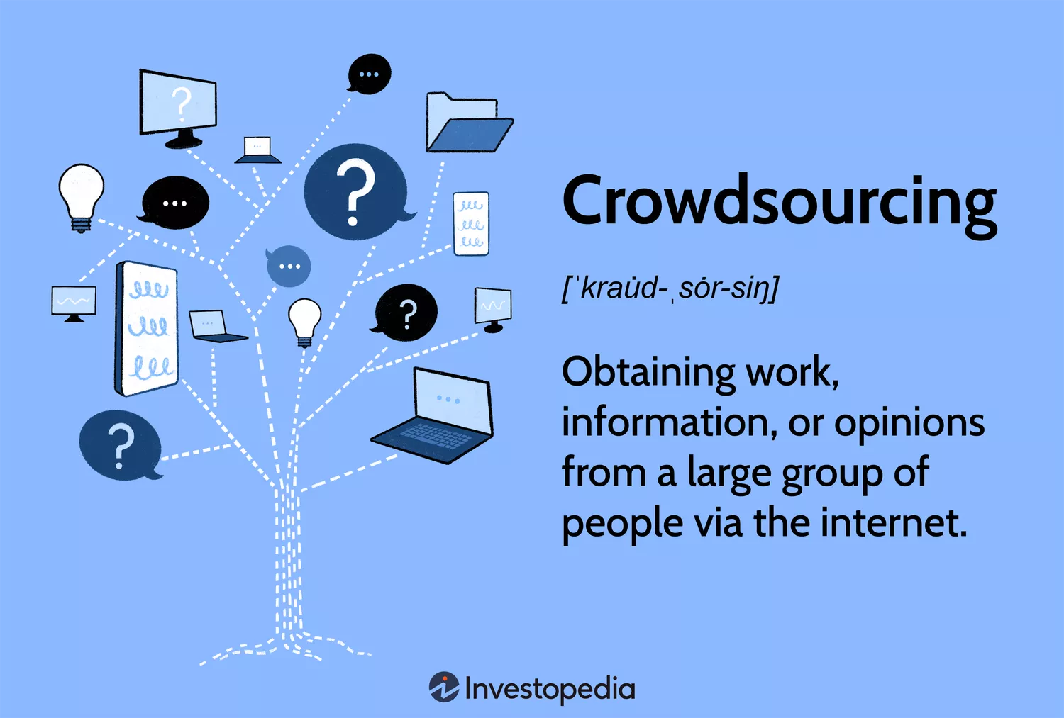

Ways to Gather - Crowdsourcing
Notes:
https://www.investopedia.com/terms/c/crowdsourcing.asp

Slide 9
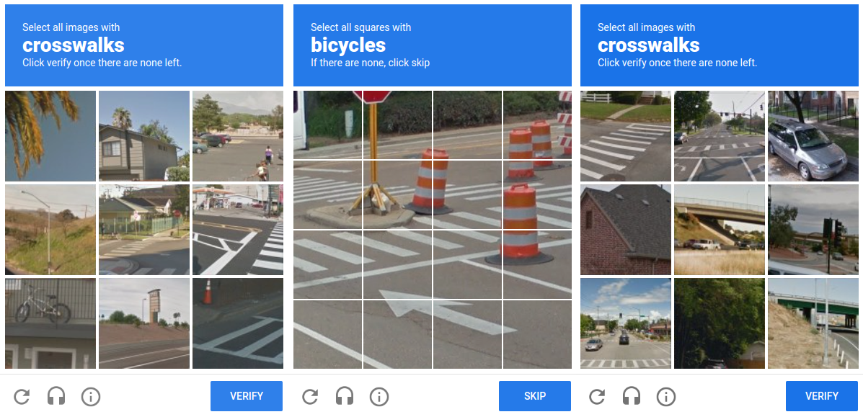
Notes:
What is this? What are you doing when you click it? recaptcha

Slide 10
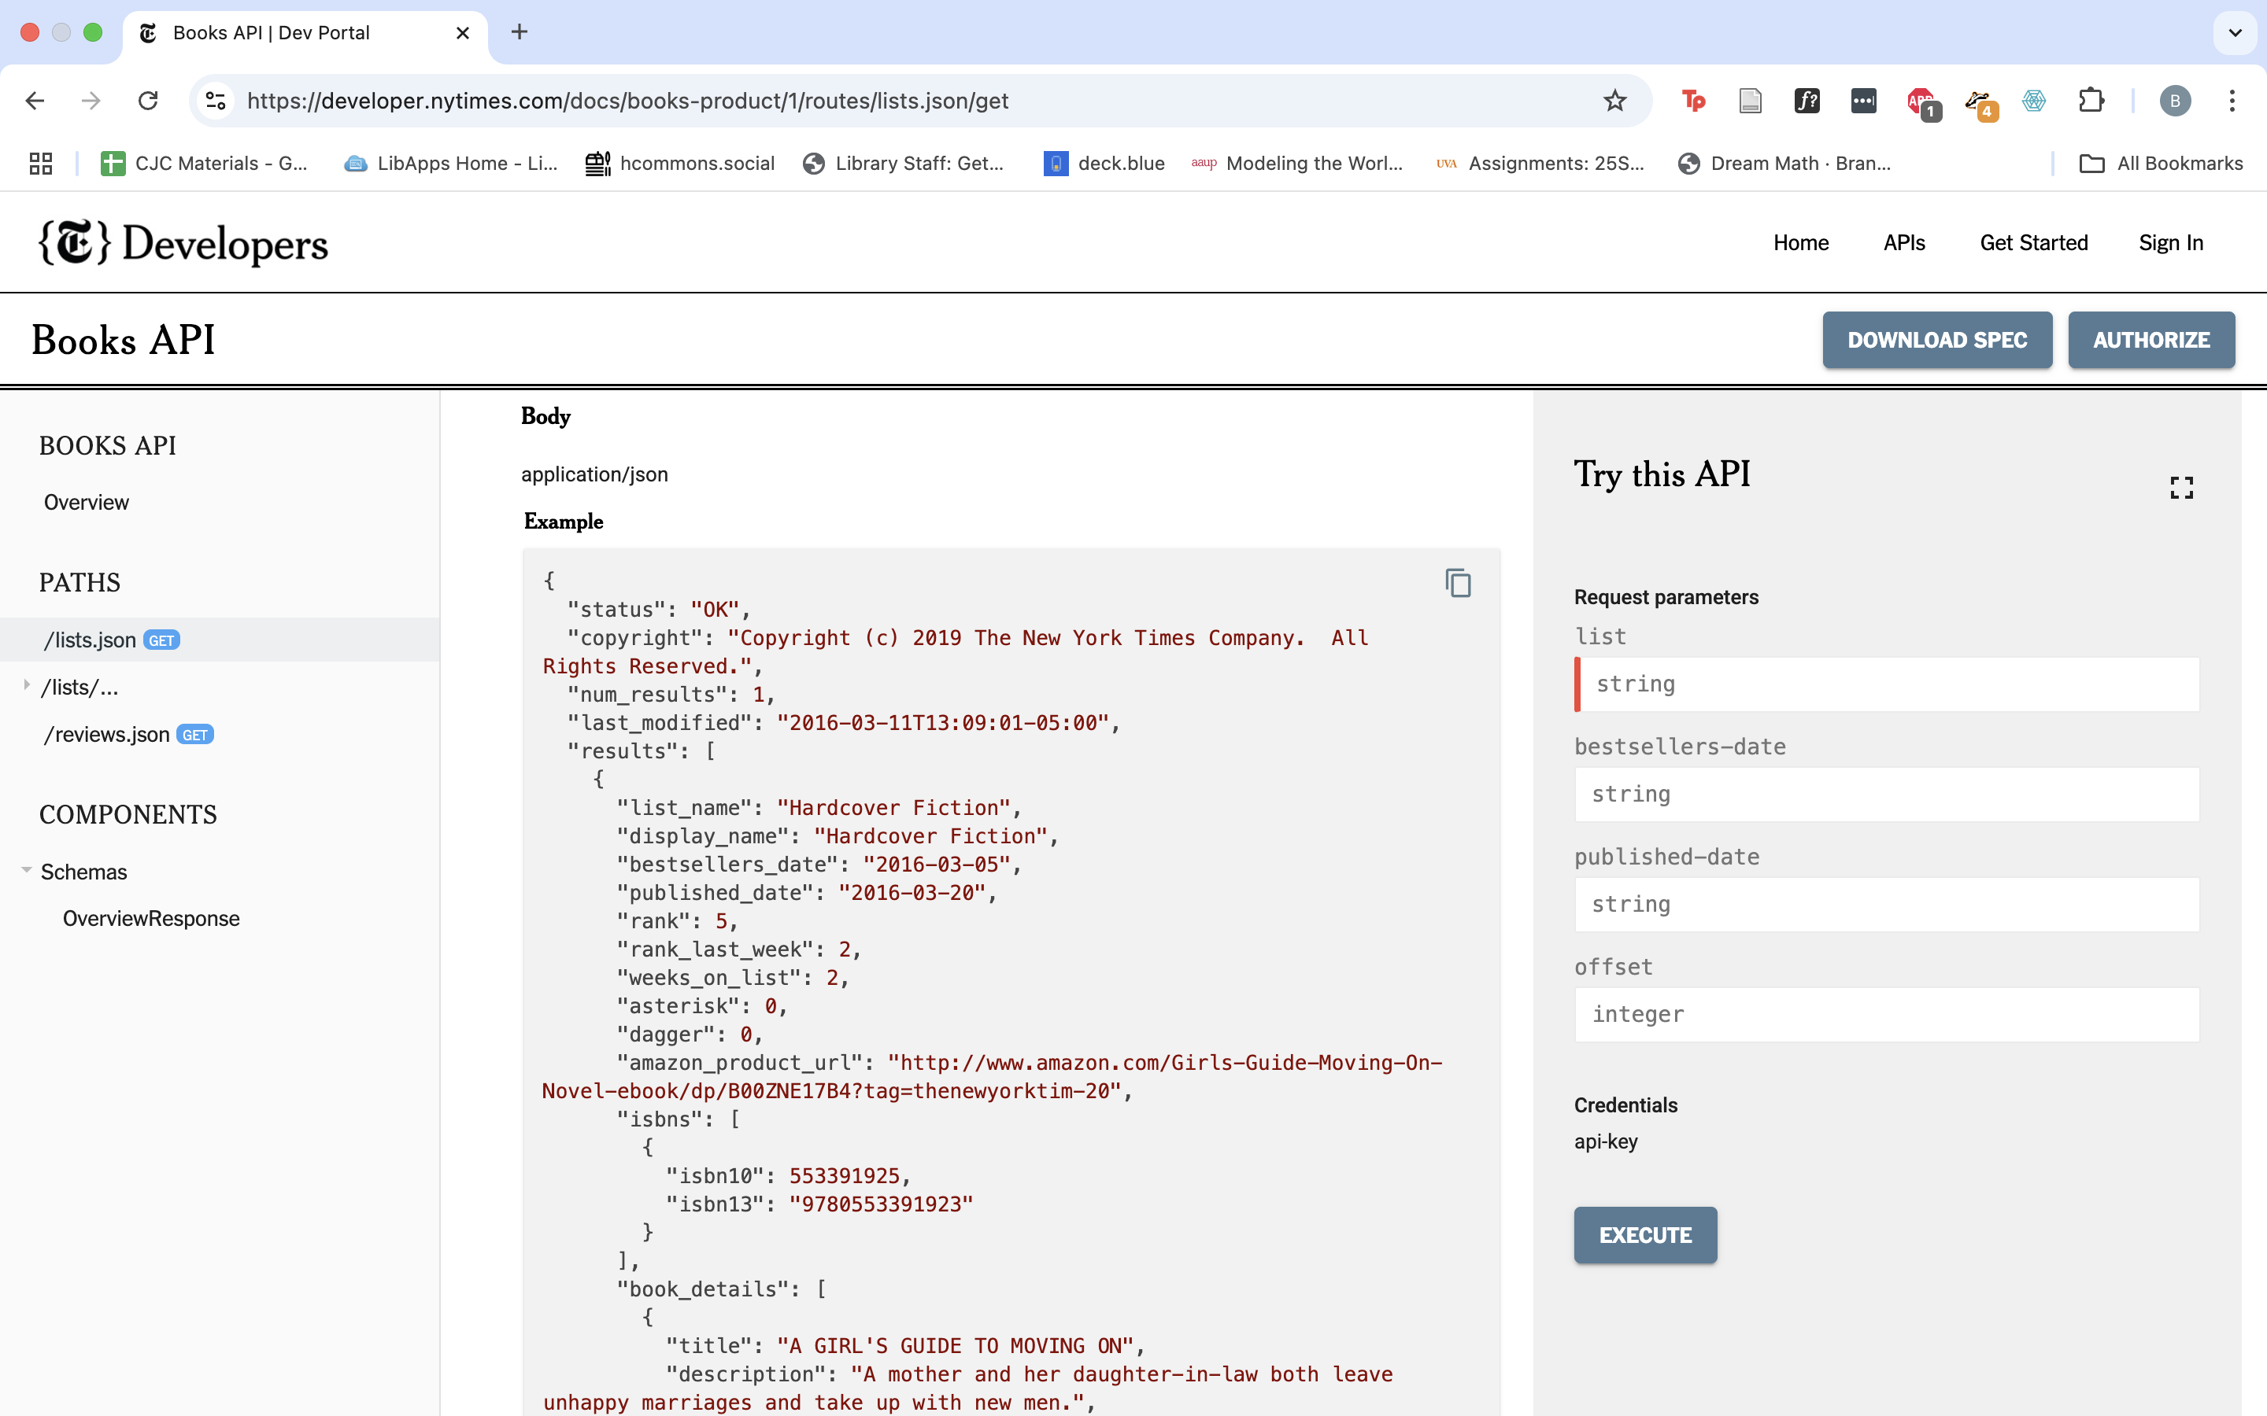
API (Application Programming Interface)

Slide 11
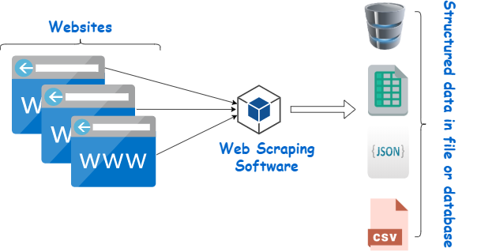
How to Gather – Web Scraping
Notes:
https://www.webharvy.com/articles/what-is-web-scraping.html

Slide 12
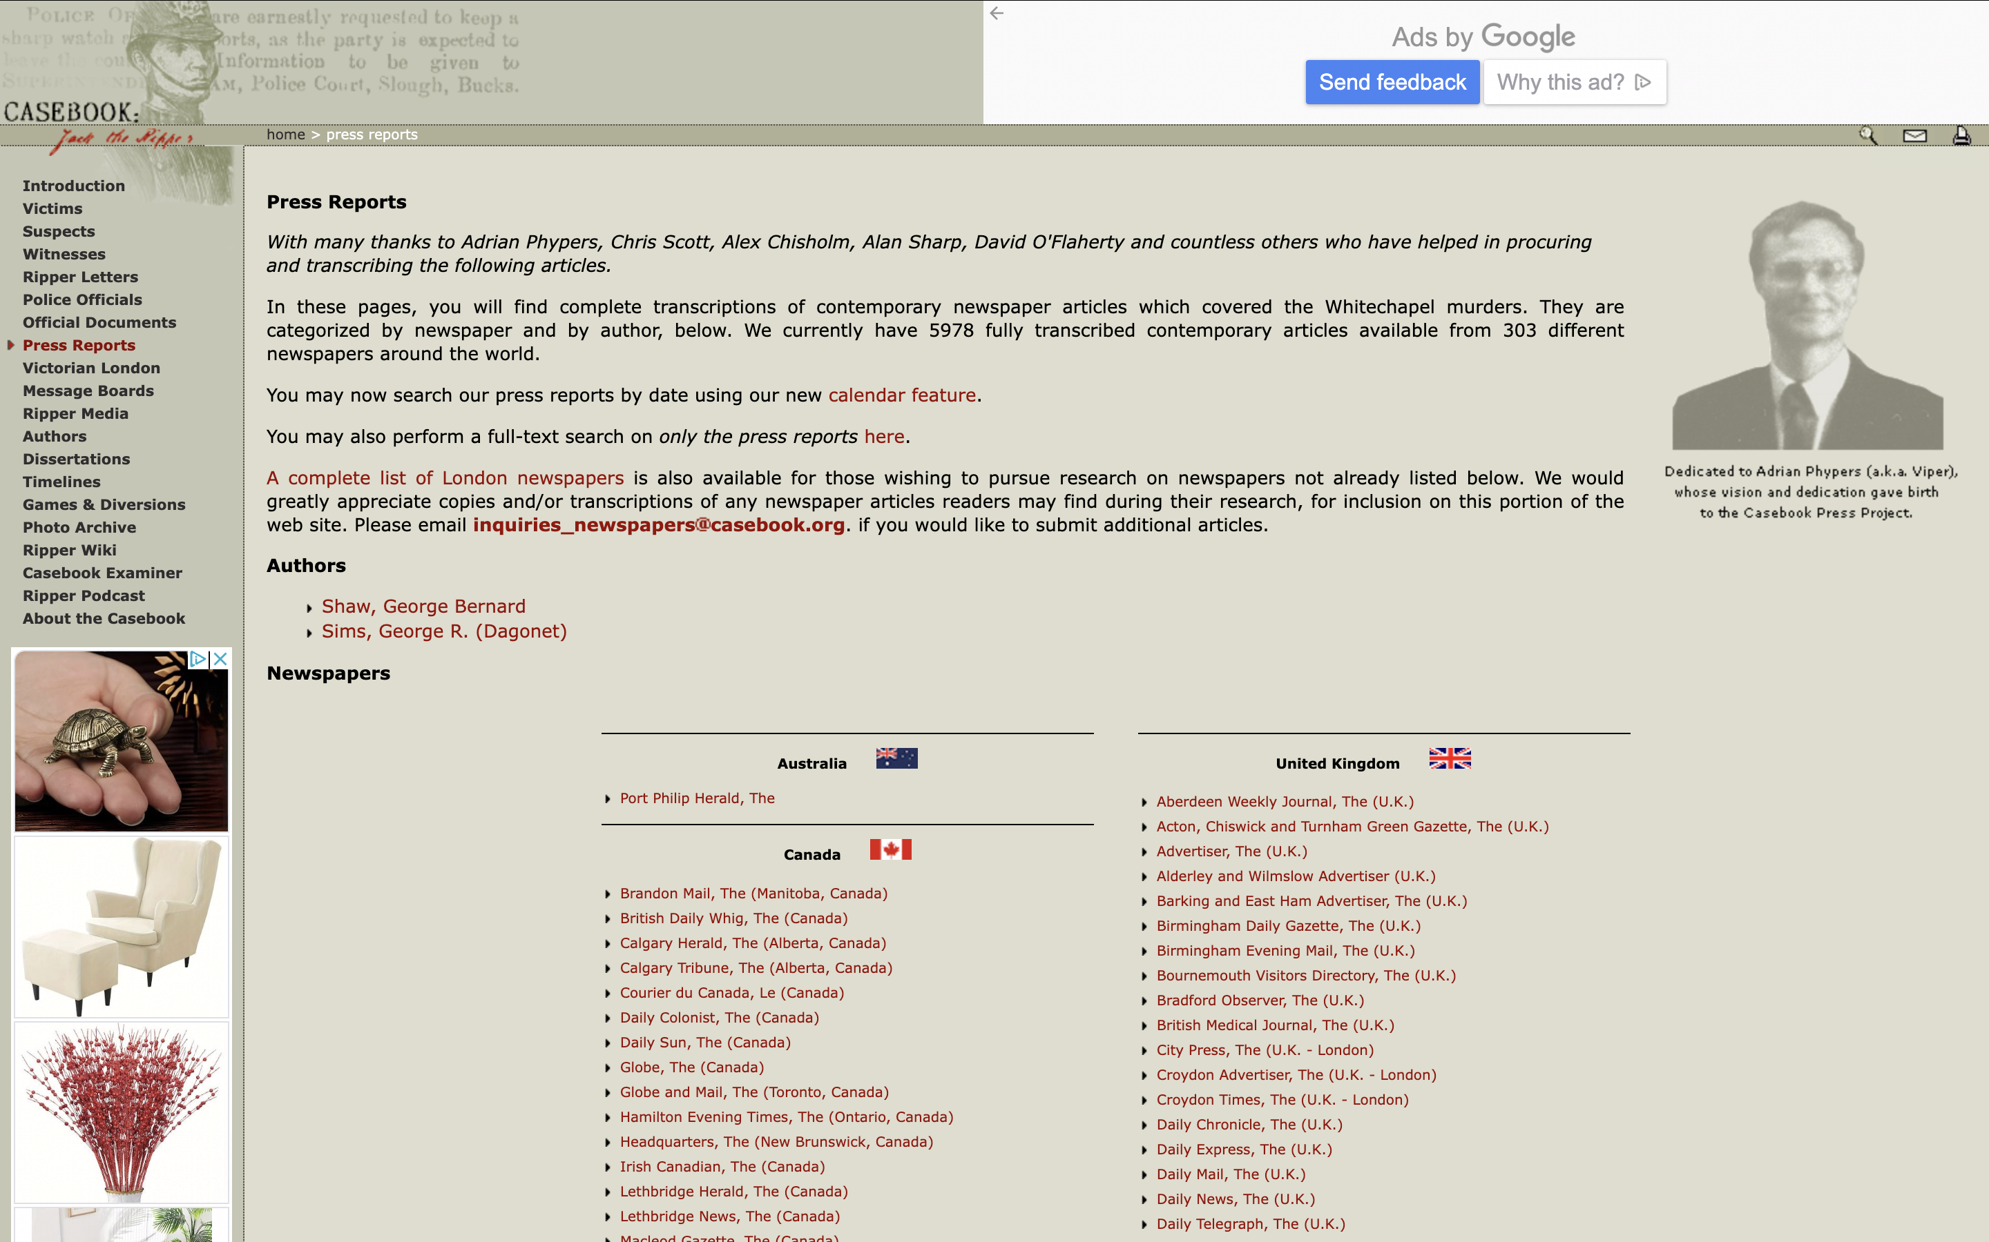
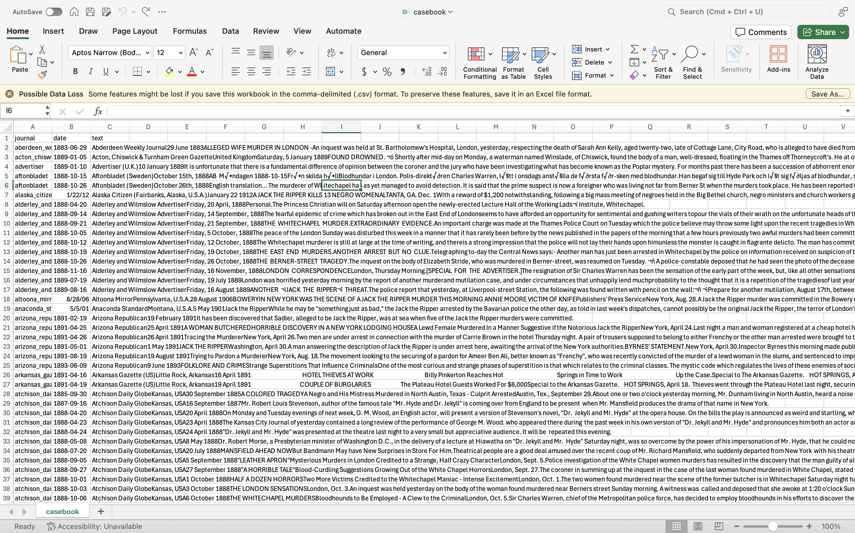
How to Gather – Web Scraping
Notes:
https://www.webharvy.com/articles/what-is-web-scraping.html

Slide 13
How to Scrape - webscraper.io
Options!
Free tools
Speed, scale limitations
Paid Tools
Cost money
Often a lot quicker and more powerful
Custom-built scrapers
Can do just about whatever you want – takes programming exp.
We’re going to use webscraper.io
Freemium
Give you a taste of what and how it works

Slide 14

Has everyone installed?
Notes:
Need to install chrome ahead of time and be using the same browser as well

Slide 15
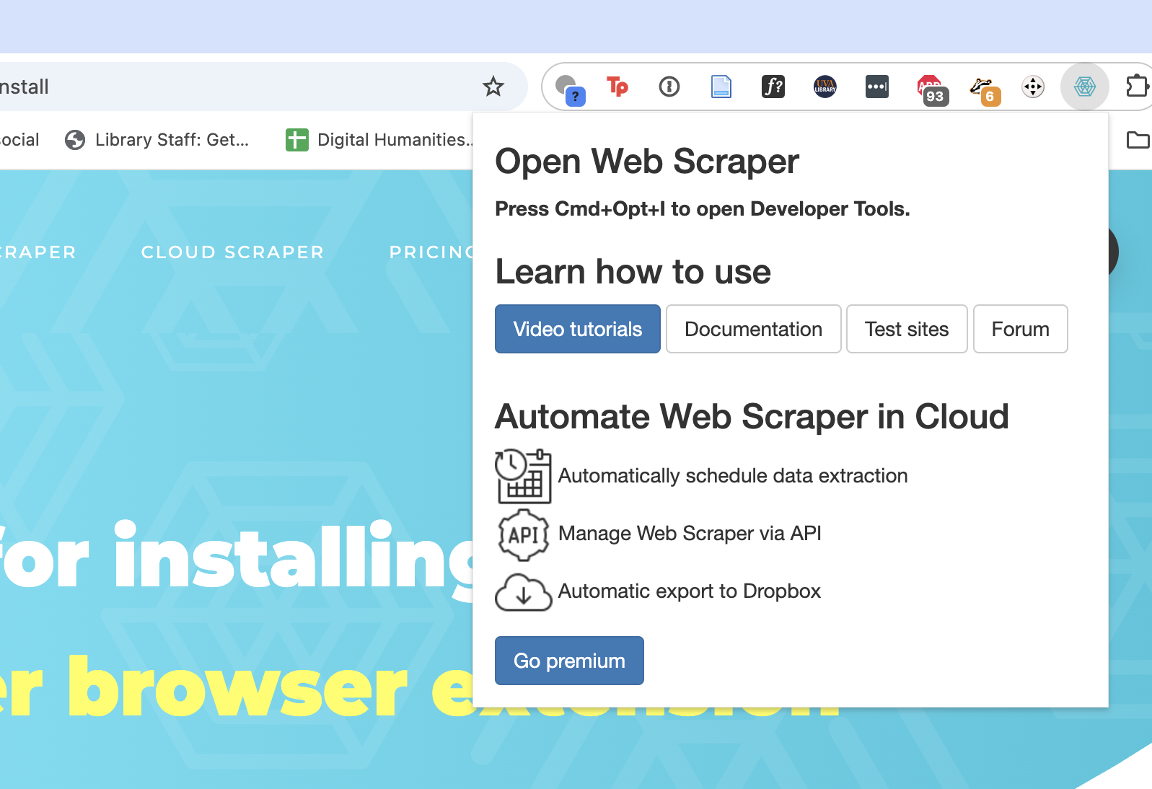
Installation Steps
Install Chrome
In chrome go to https://surveys.webscraper.io/
Click “install” then “add to chrome” in the new tab. Then “add extension”
Will either appear in your extensions bar by default or you might have to click on the “extensions” button and pin it
You know you’re good when you see this ->
Notes:
Maybe do screenshots?

Slide 16
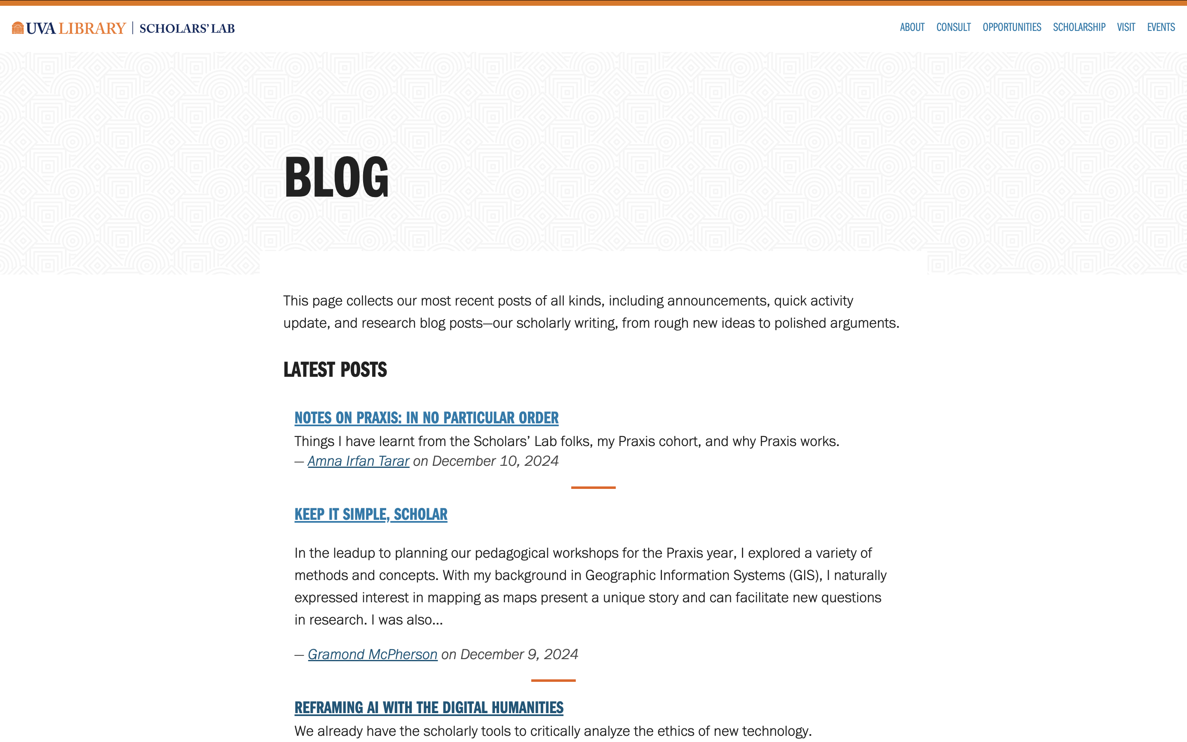
https://scholarslab.lib.virginia.edu/blog/
Notes:
This is what we will be scraping. So go to that page and open the extension

Slide 17
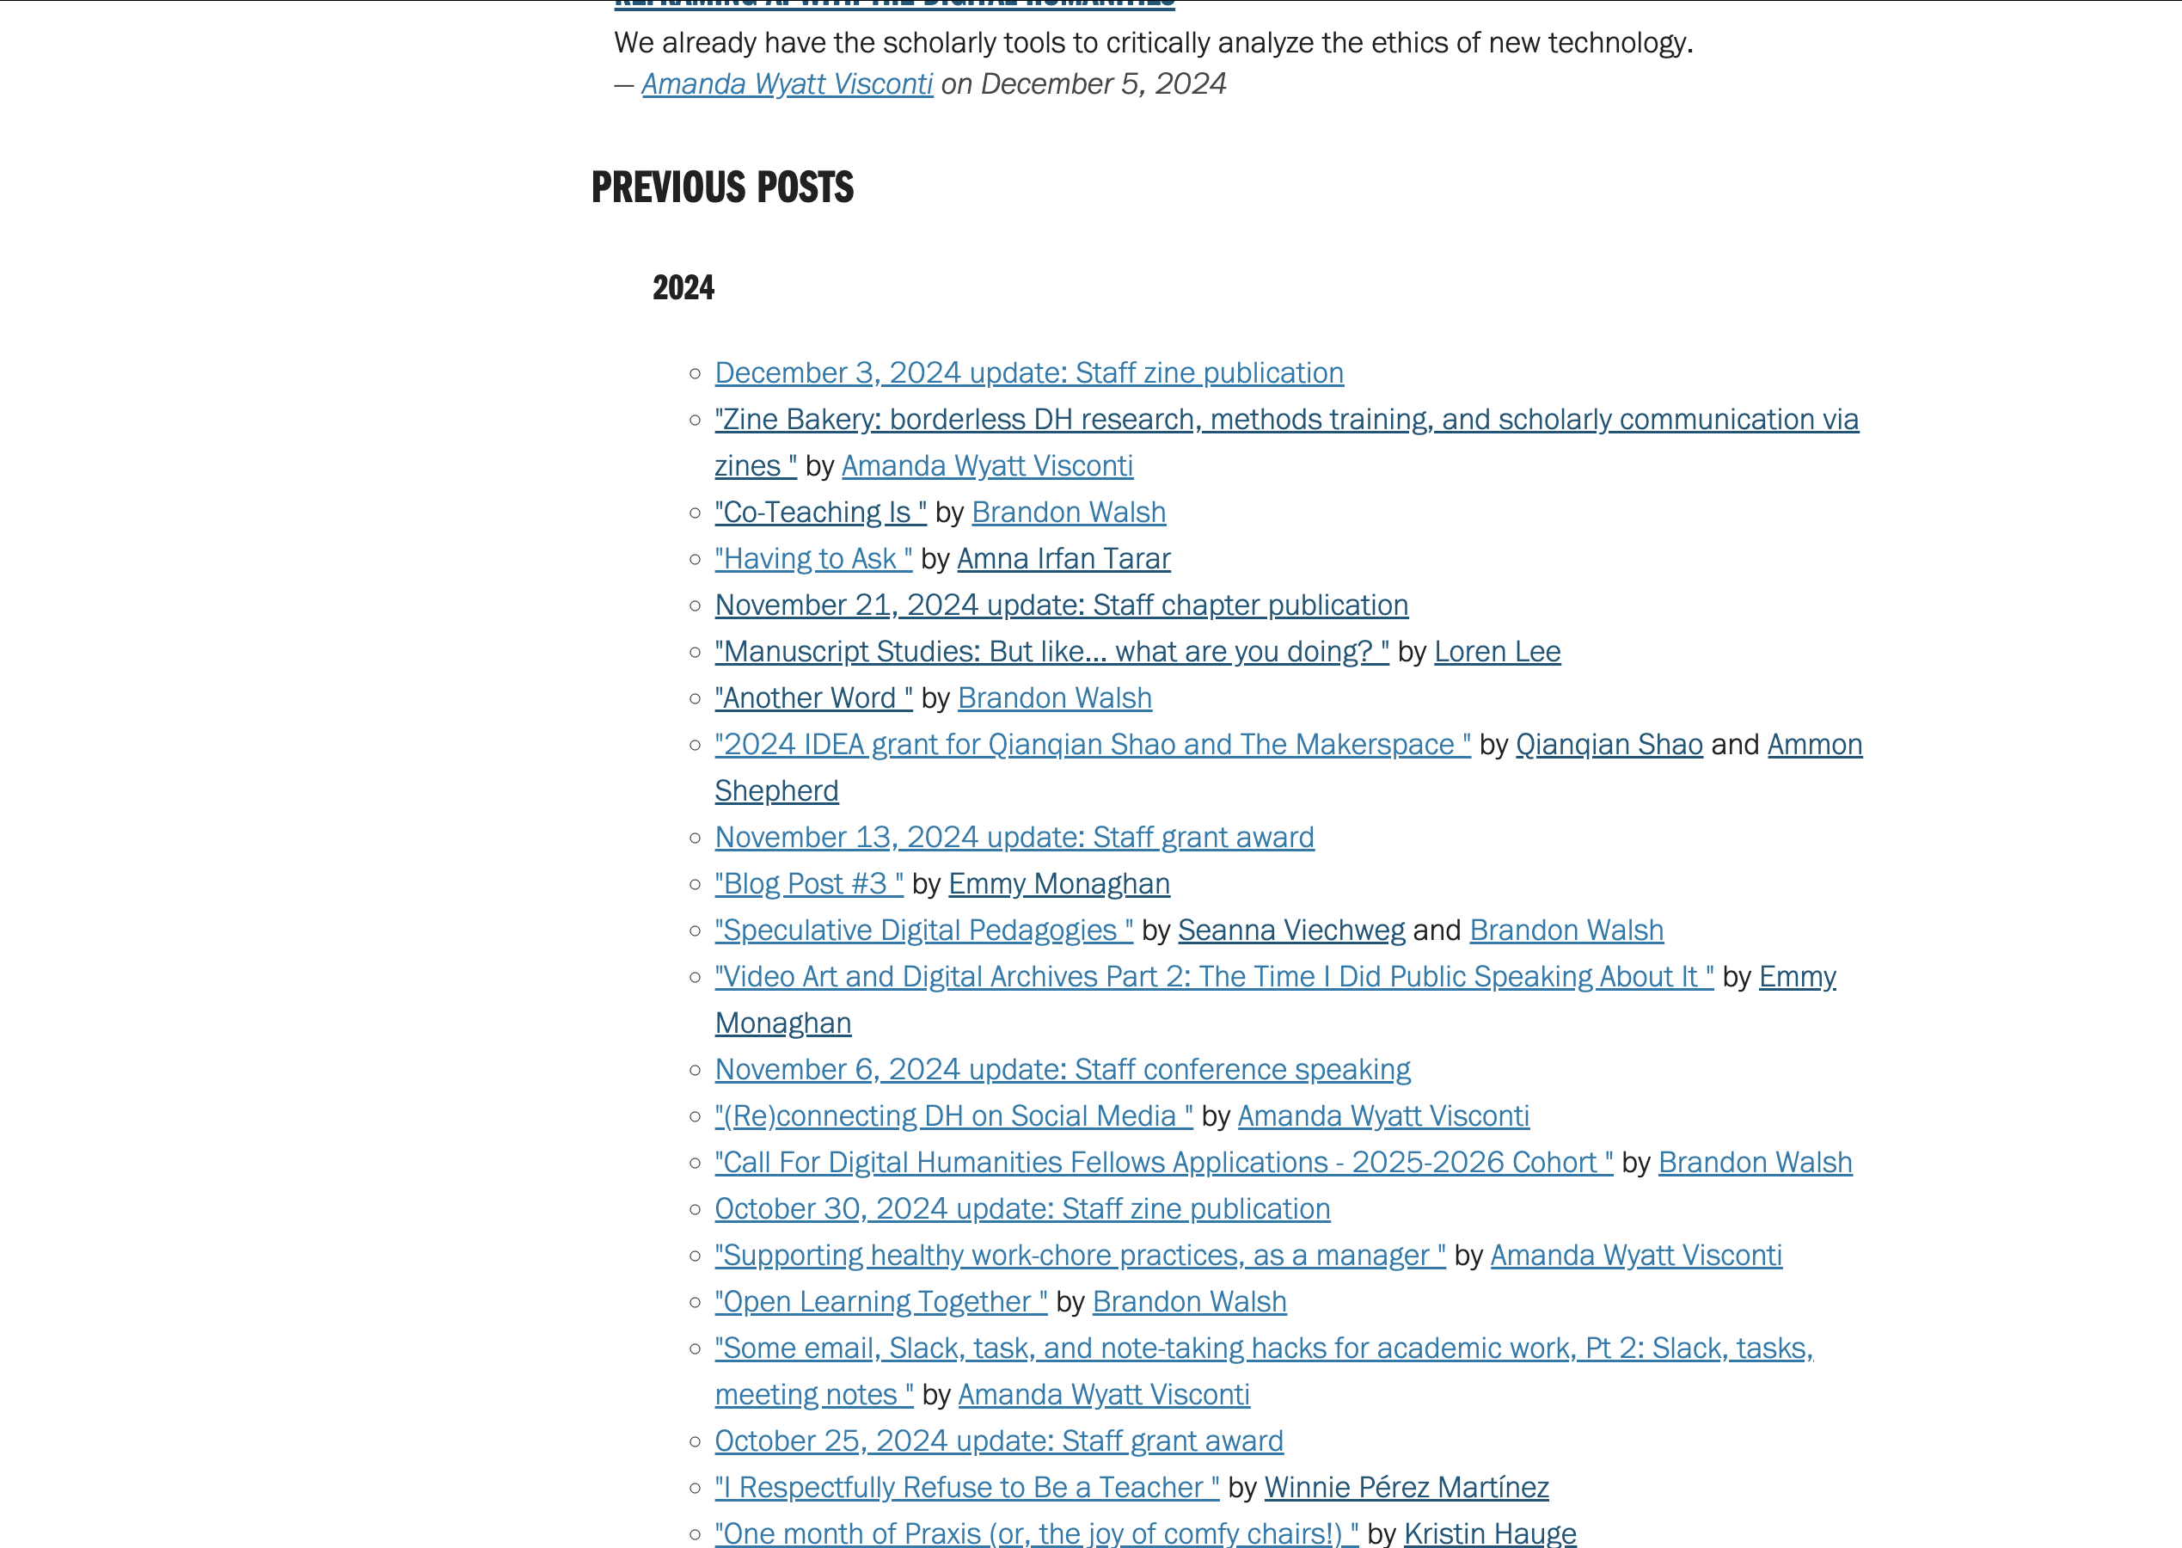
What makes this good for scraping?
All on one page!
Pagination can also work but is harder
Having to log in or dynamically render a page often prohibitive
Essentially copy and pasting at scale – works well when it’s mindless and tedious
Notes:
Maybe do screenshots?

Slide 18
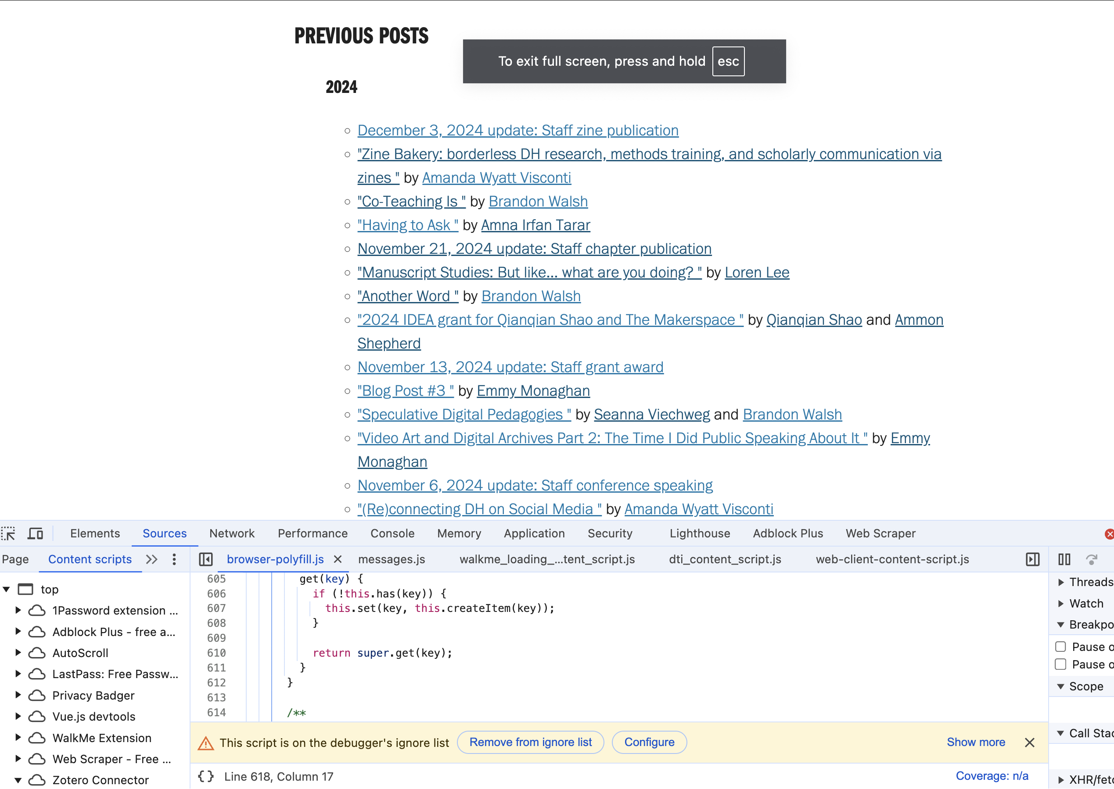
Opening Developer Tools
Cmd + opt + I on mac
View -> developer
-> developer tools on Windows
Different in each browser
Using Chrome to standardize
It’s a space where you can do lots of tinkering with the underlying code for a webpage.
Should see web scraper tab at right – we installed that!
Notes:
Maybe do screenshots?

Slide 19
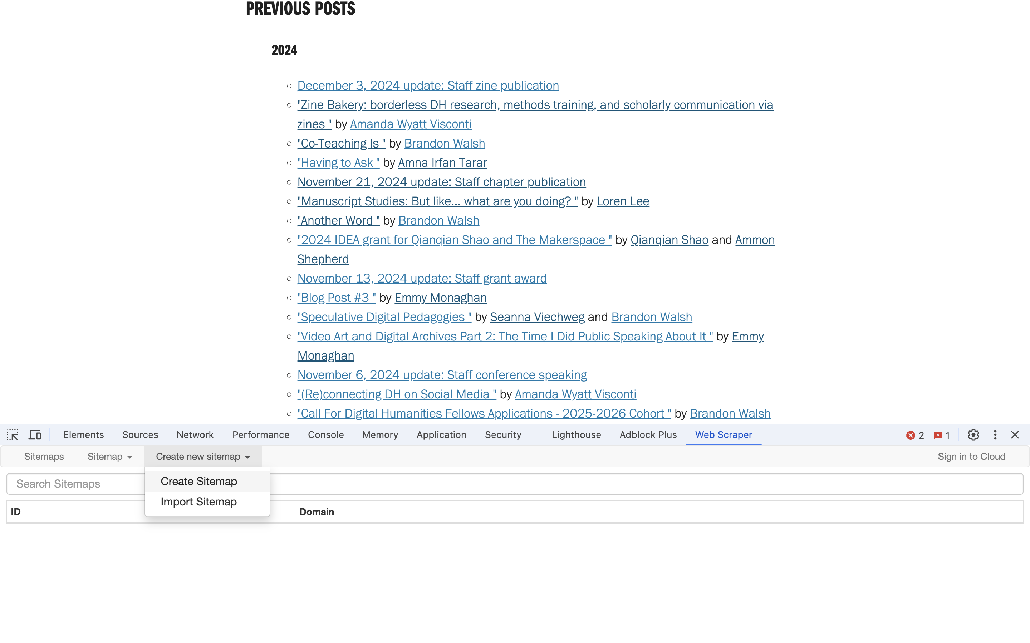
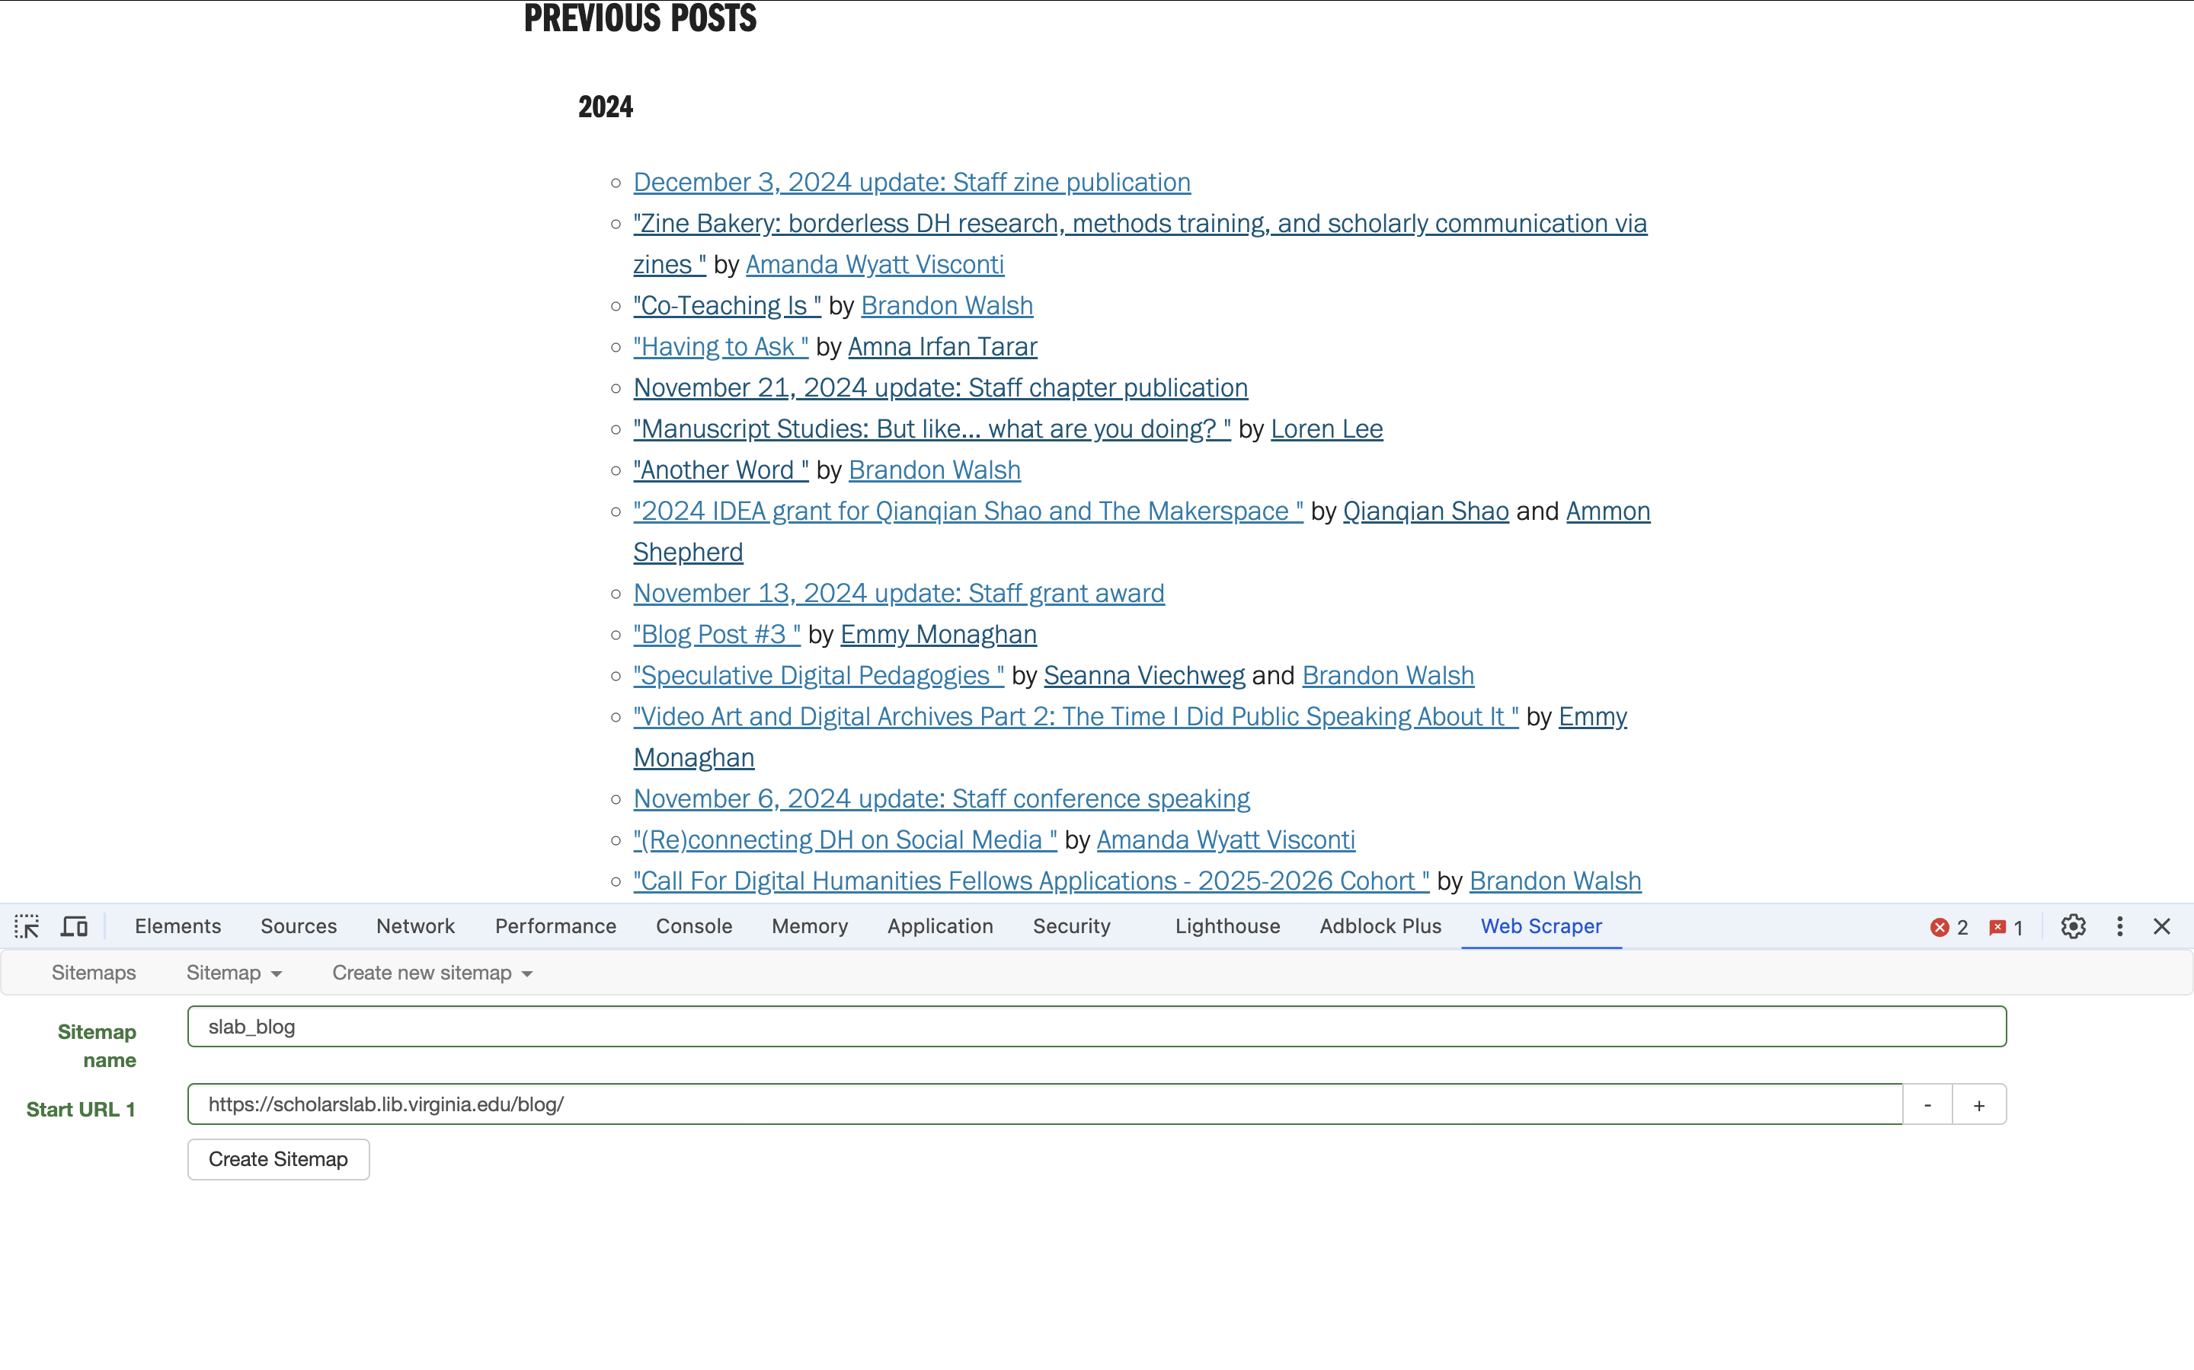
Create a Sitemap
Sitemaps list the relationships on the site of interest
We have to specify the name (whatever you want) and the start url –
https://scholarslab.lib.virginia.edu/blog/
Create new sitemap
Start URL is the root of our scrape
Notes:
Now show how to click through on all the individual pages and get the specific text for it

Slide 20
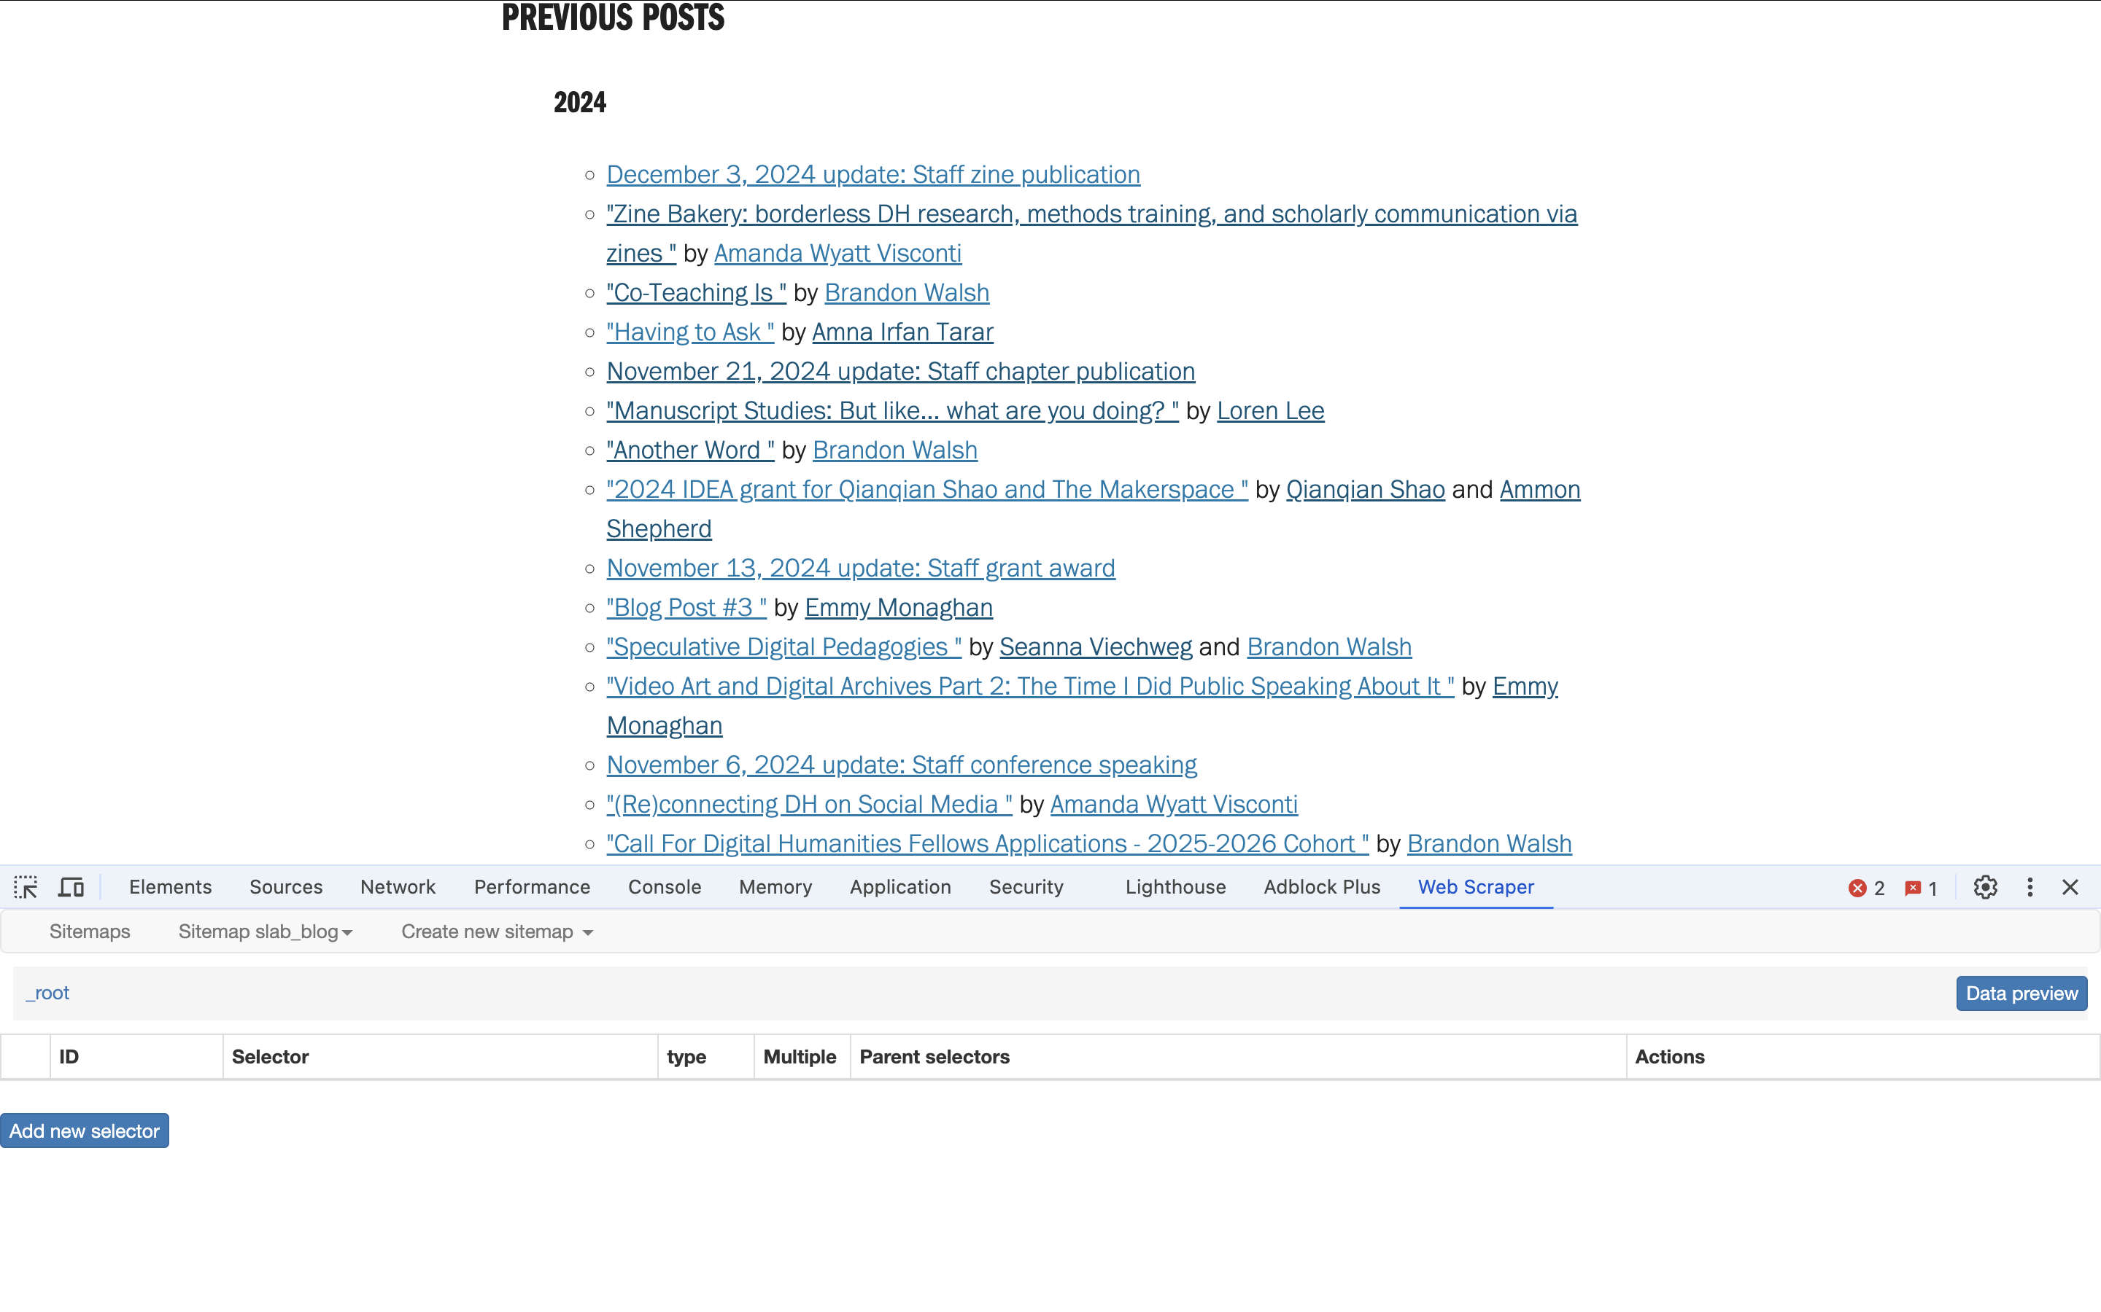
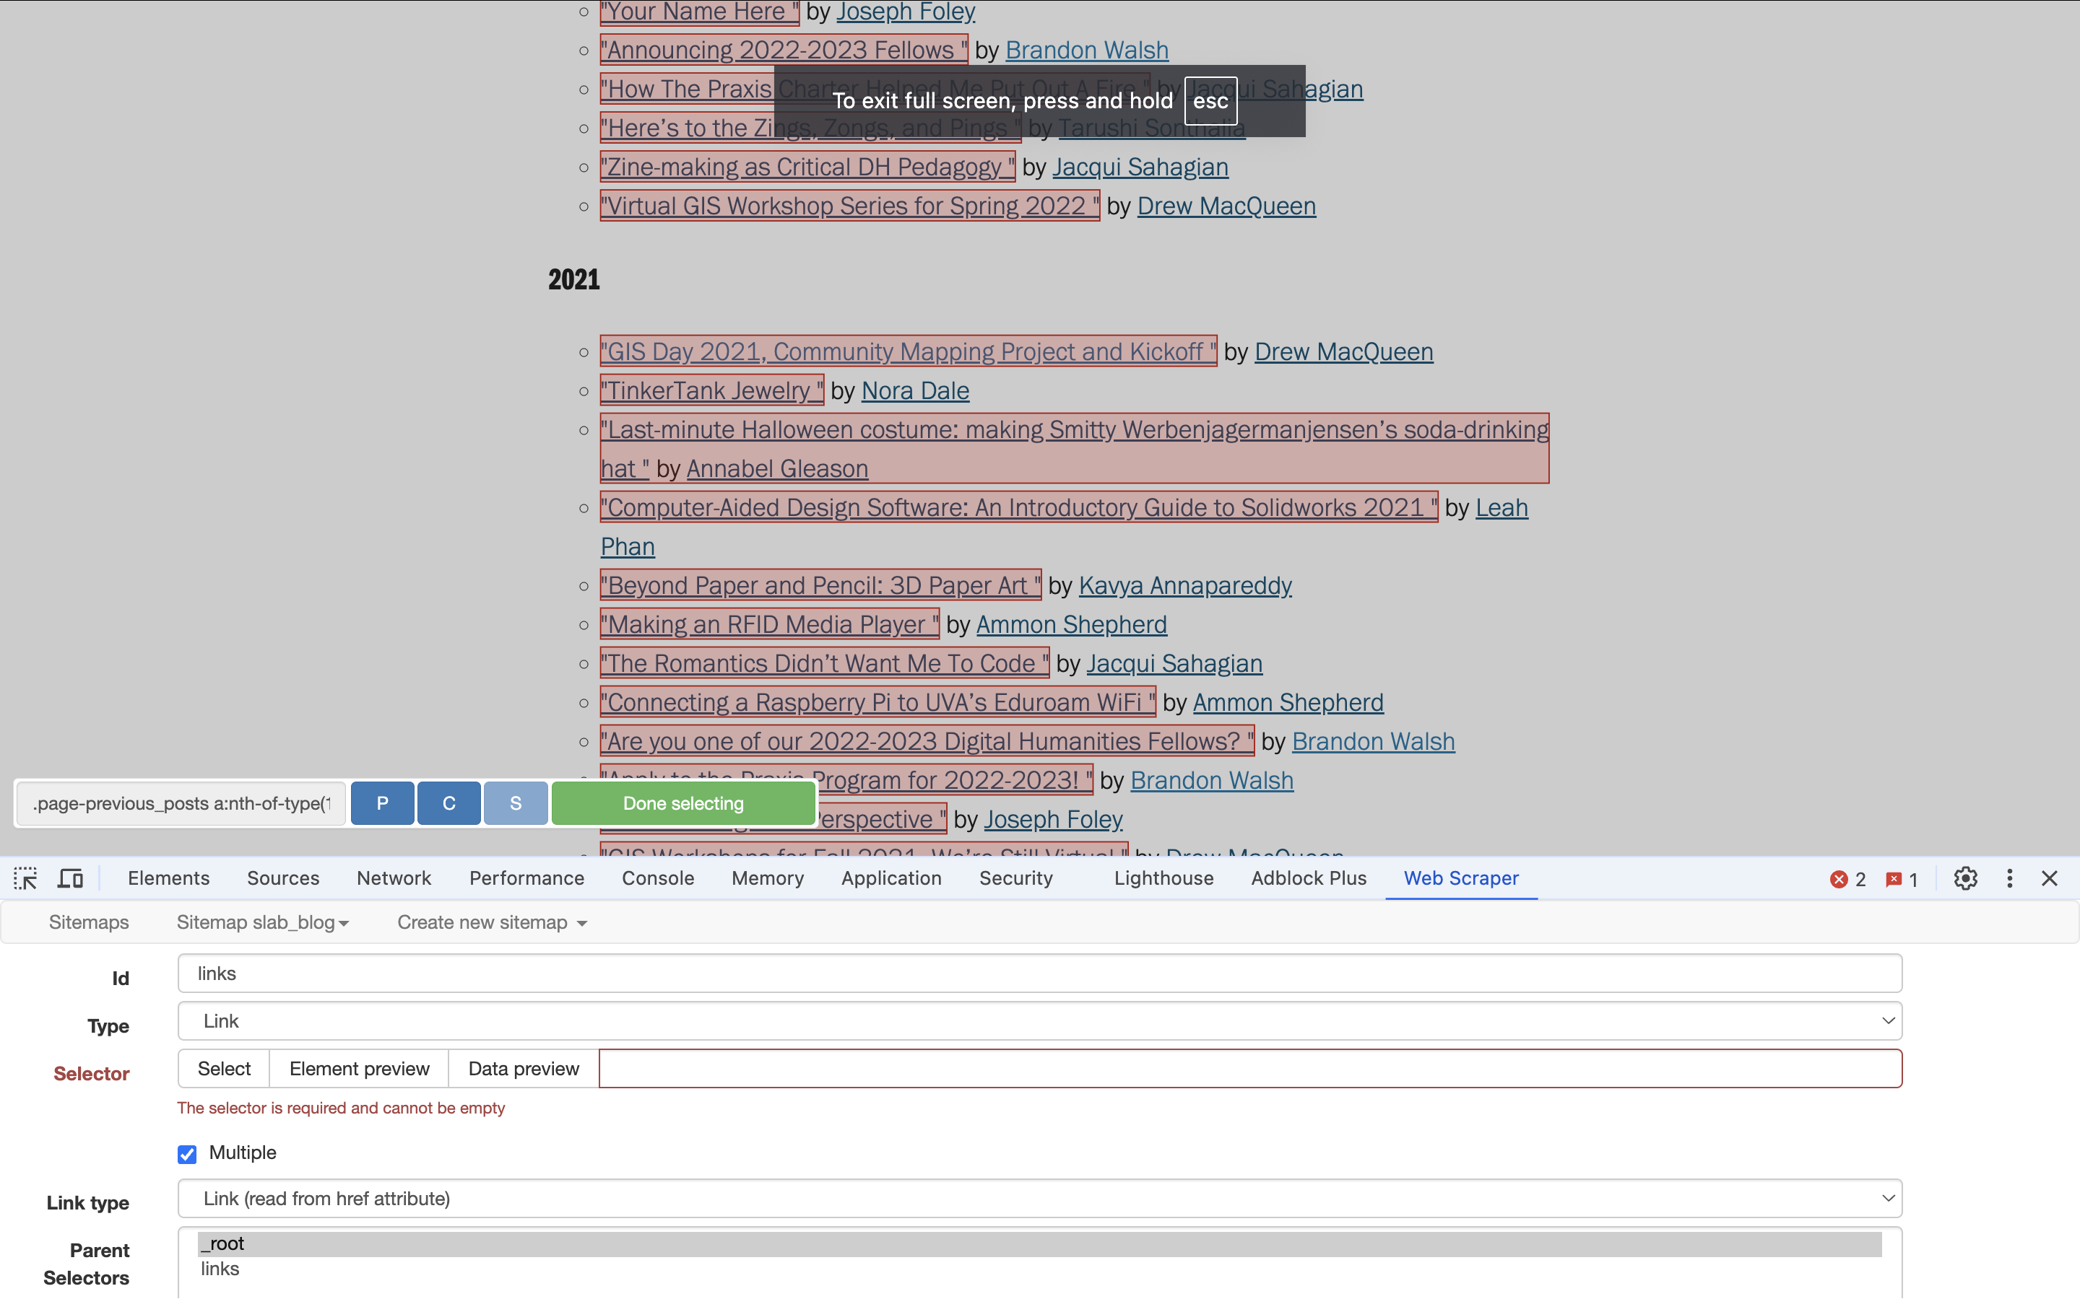
Create a Sitemap
Add a new selector
From within the next interface, click “select” and check multiple
Then click the things on the page that you want to copy.
You will have to scroll down to grab all the posts.
Why is that?
Change “type” from “text” to “link”
Why do we think we need that?
Notes:
Now show how to click through on all the individual pages and get the specific text for it

Slide 21
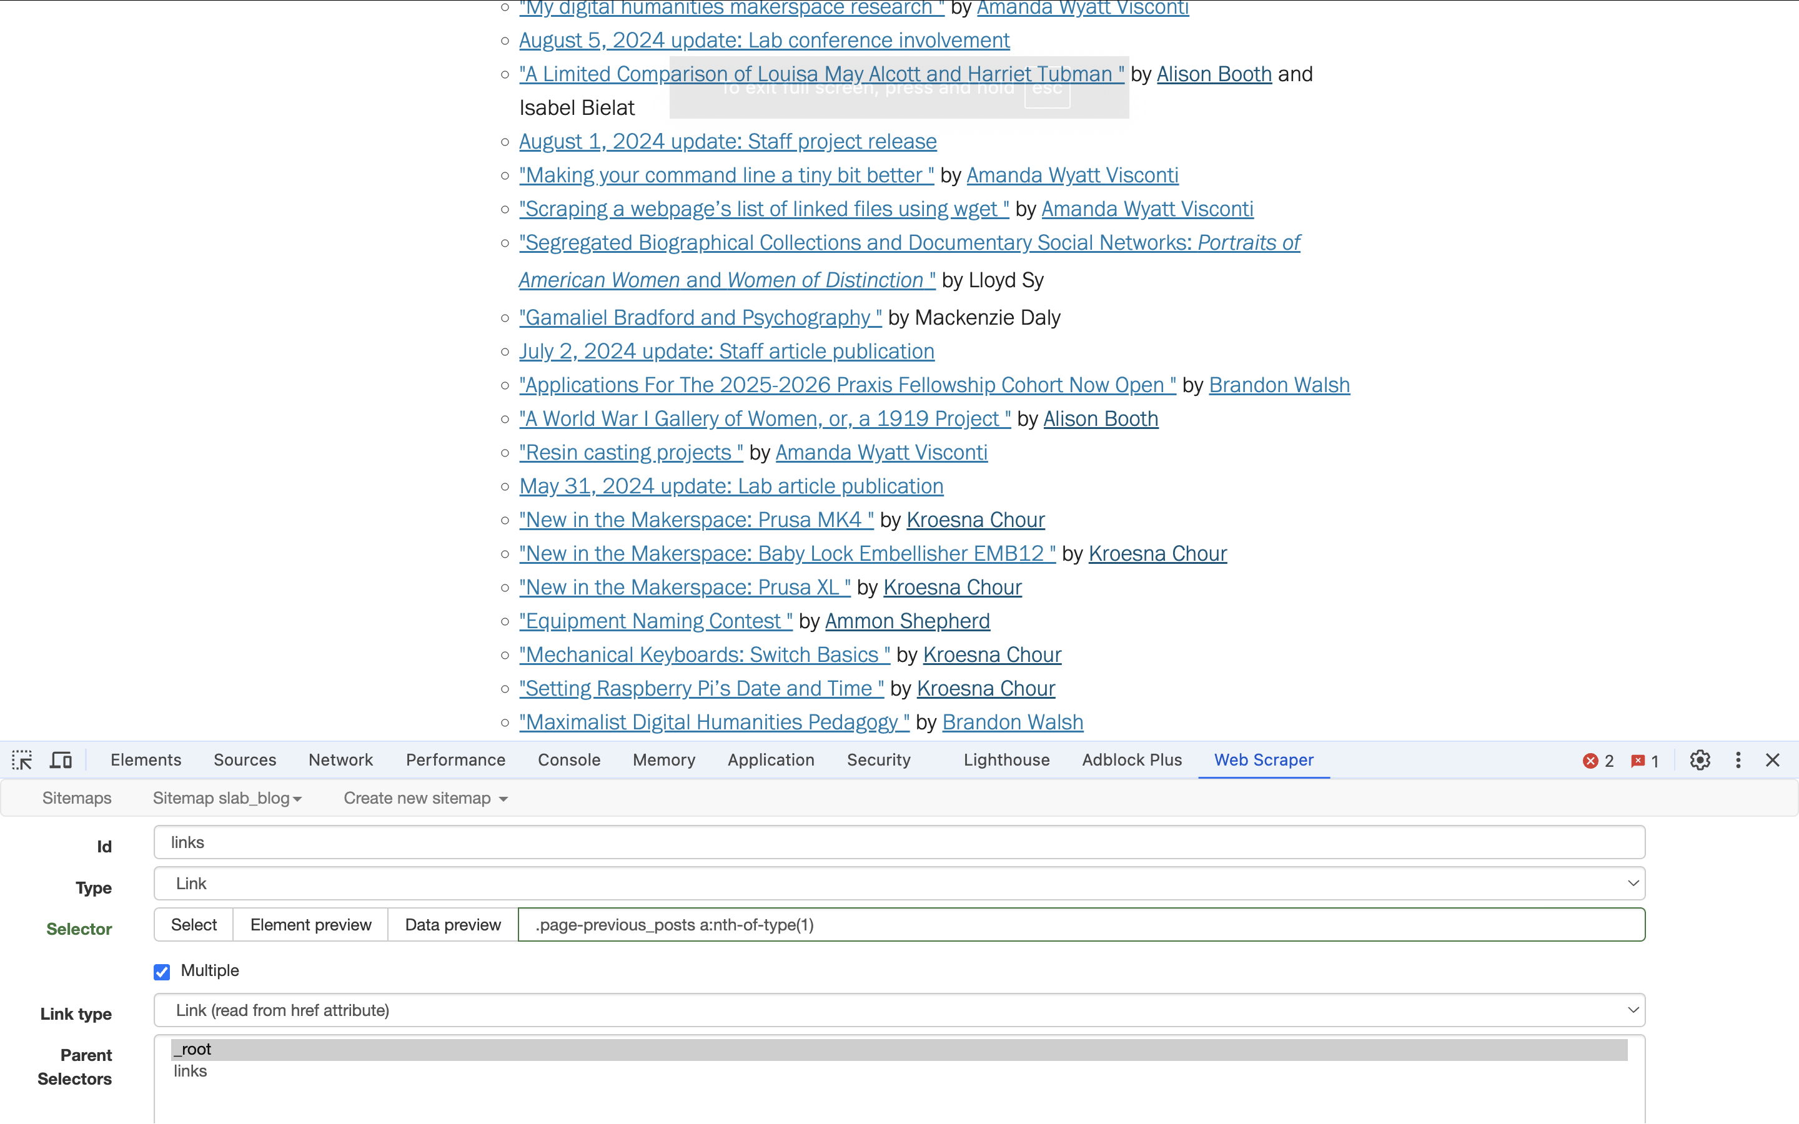
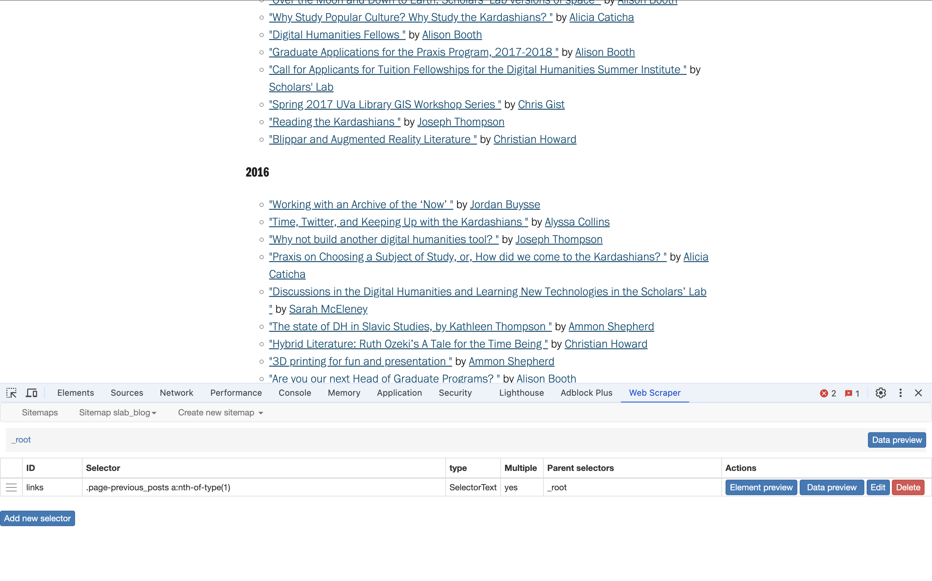
Added Selector
Click done selecting
Then save
We now have one set of things ready to be copied
Notes:
Now show how to click through on all the individual pages and get the specific text for it

Slide 22
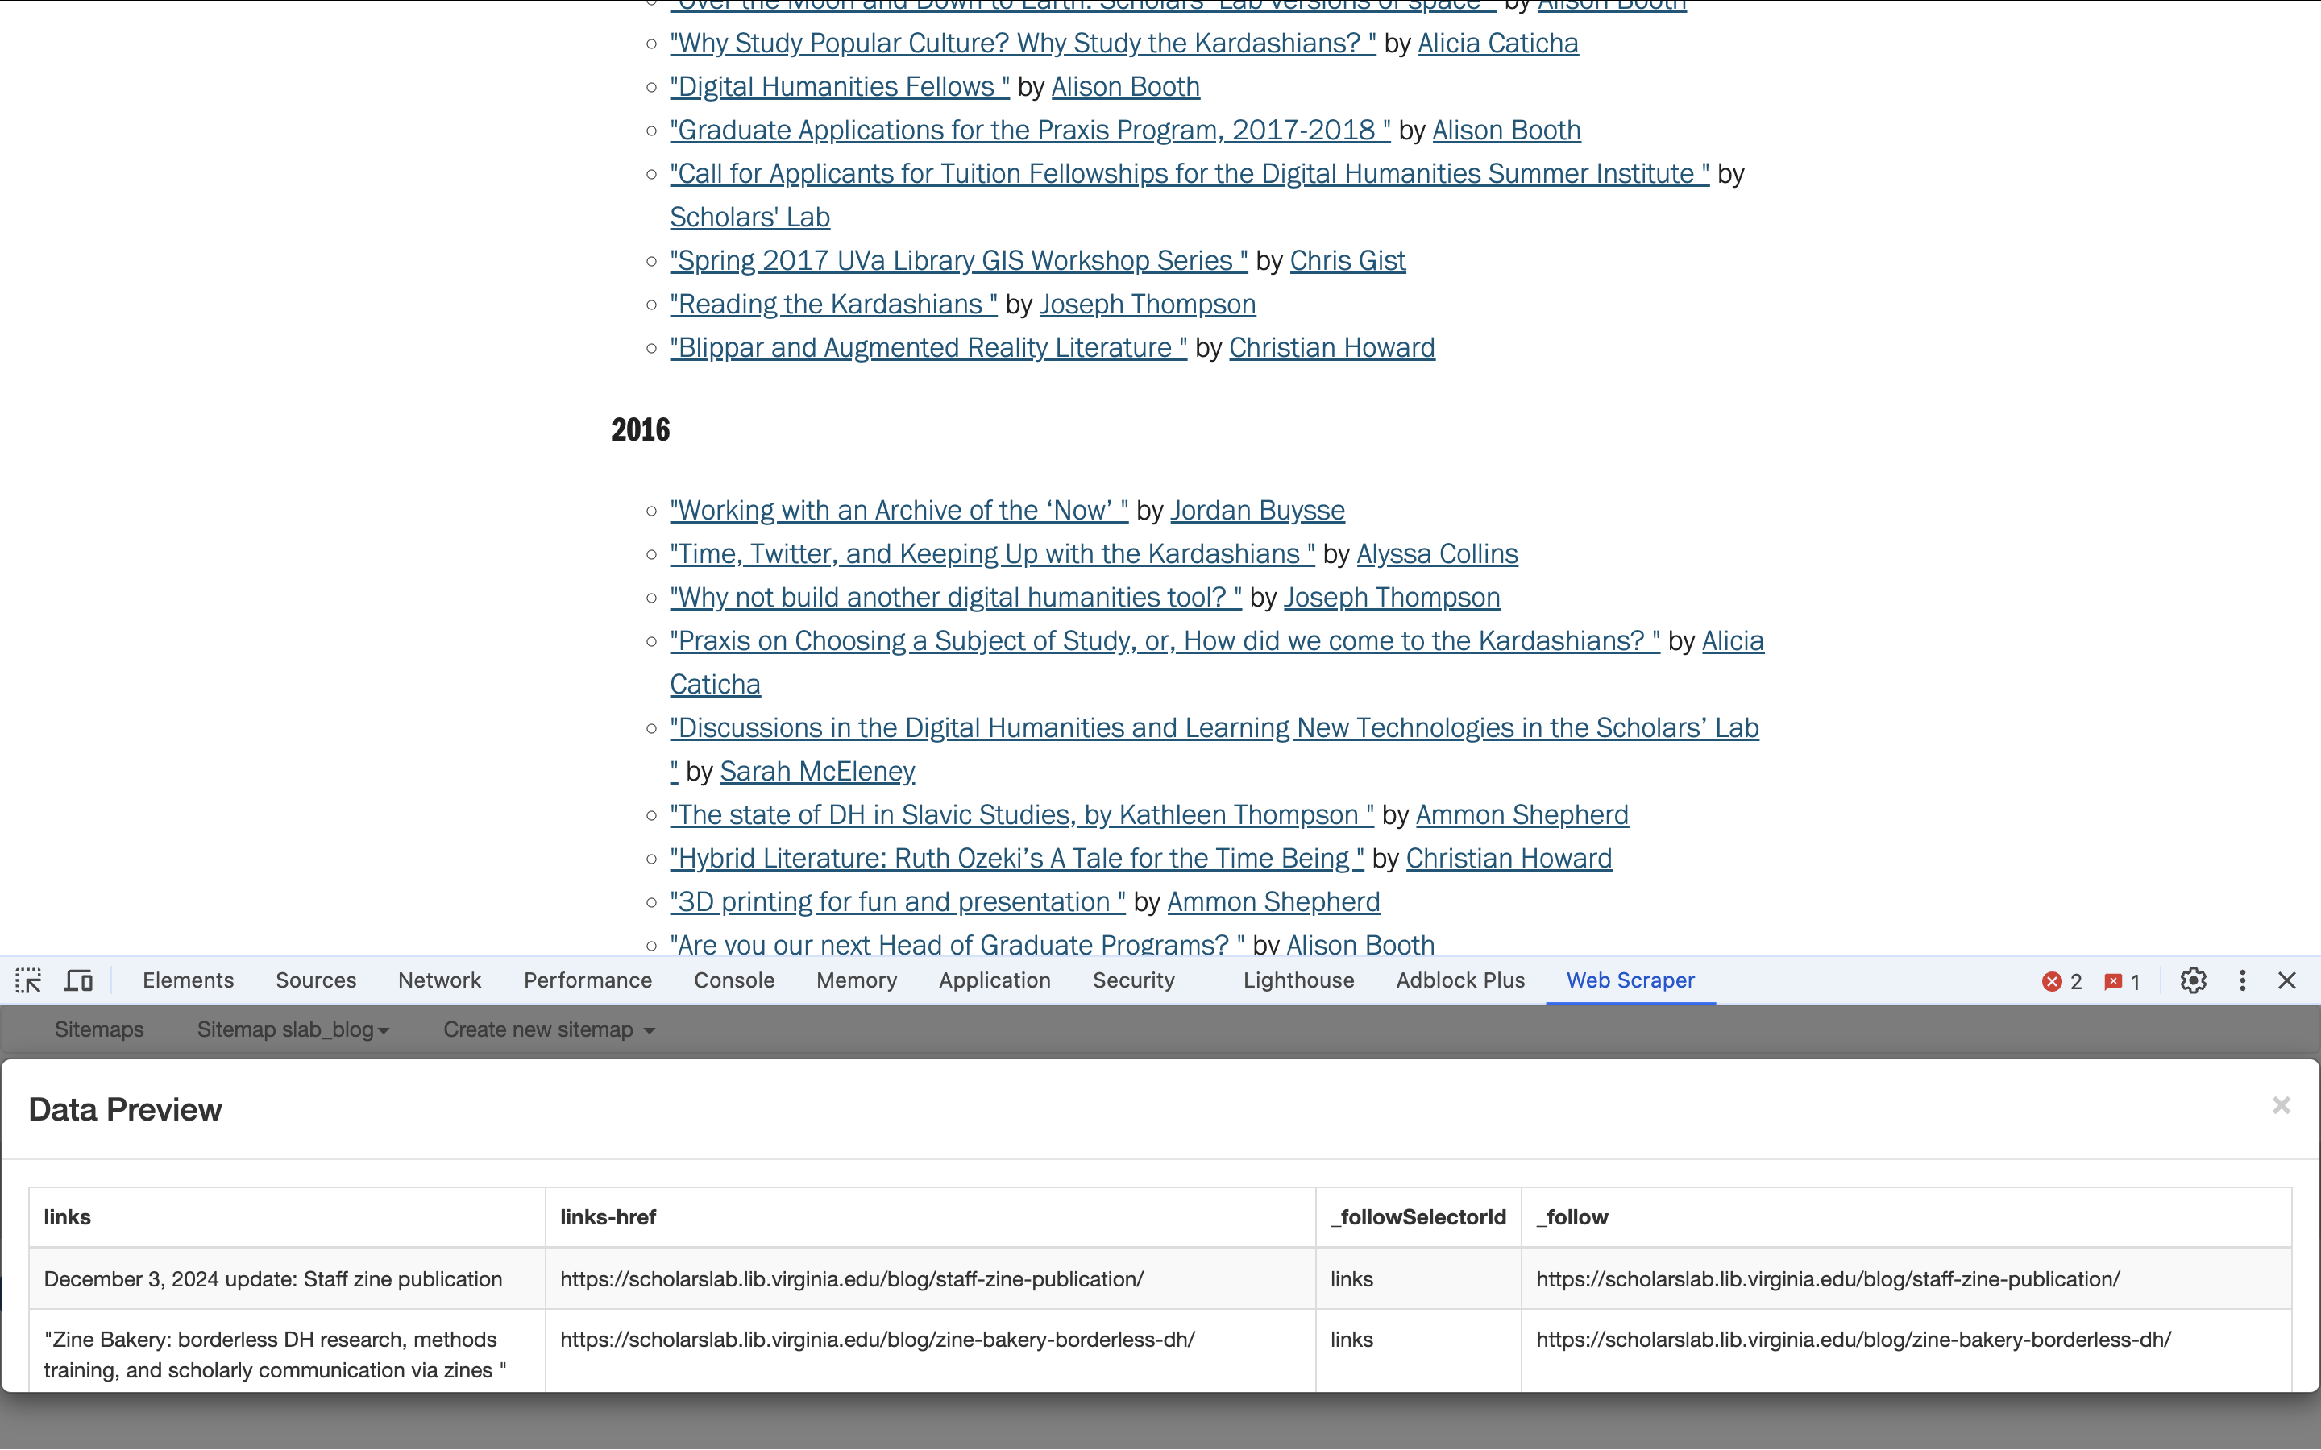
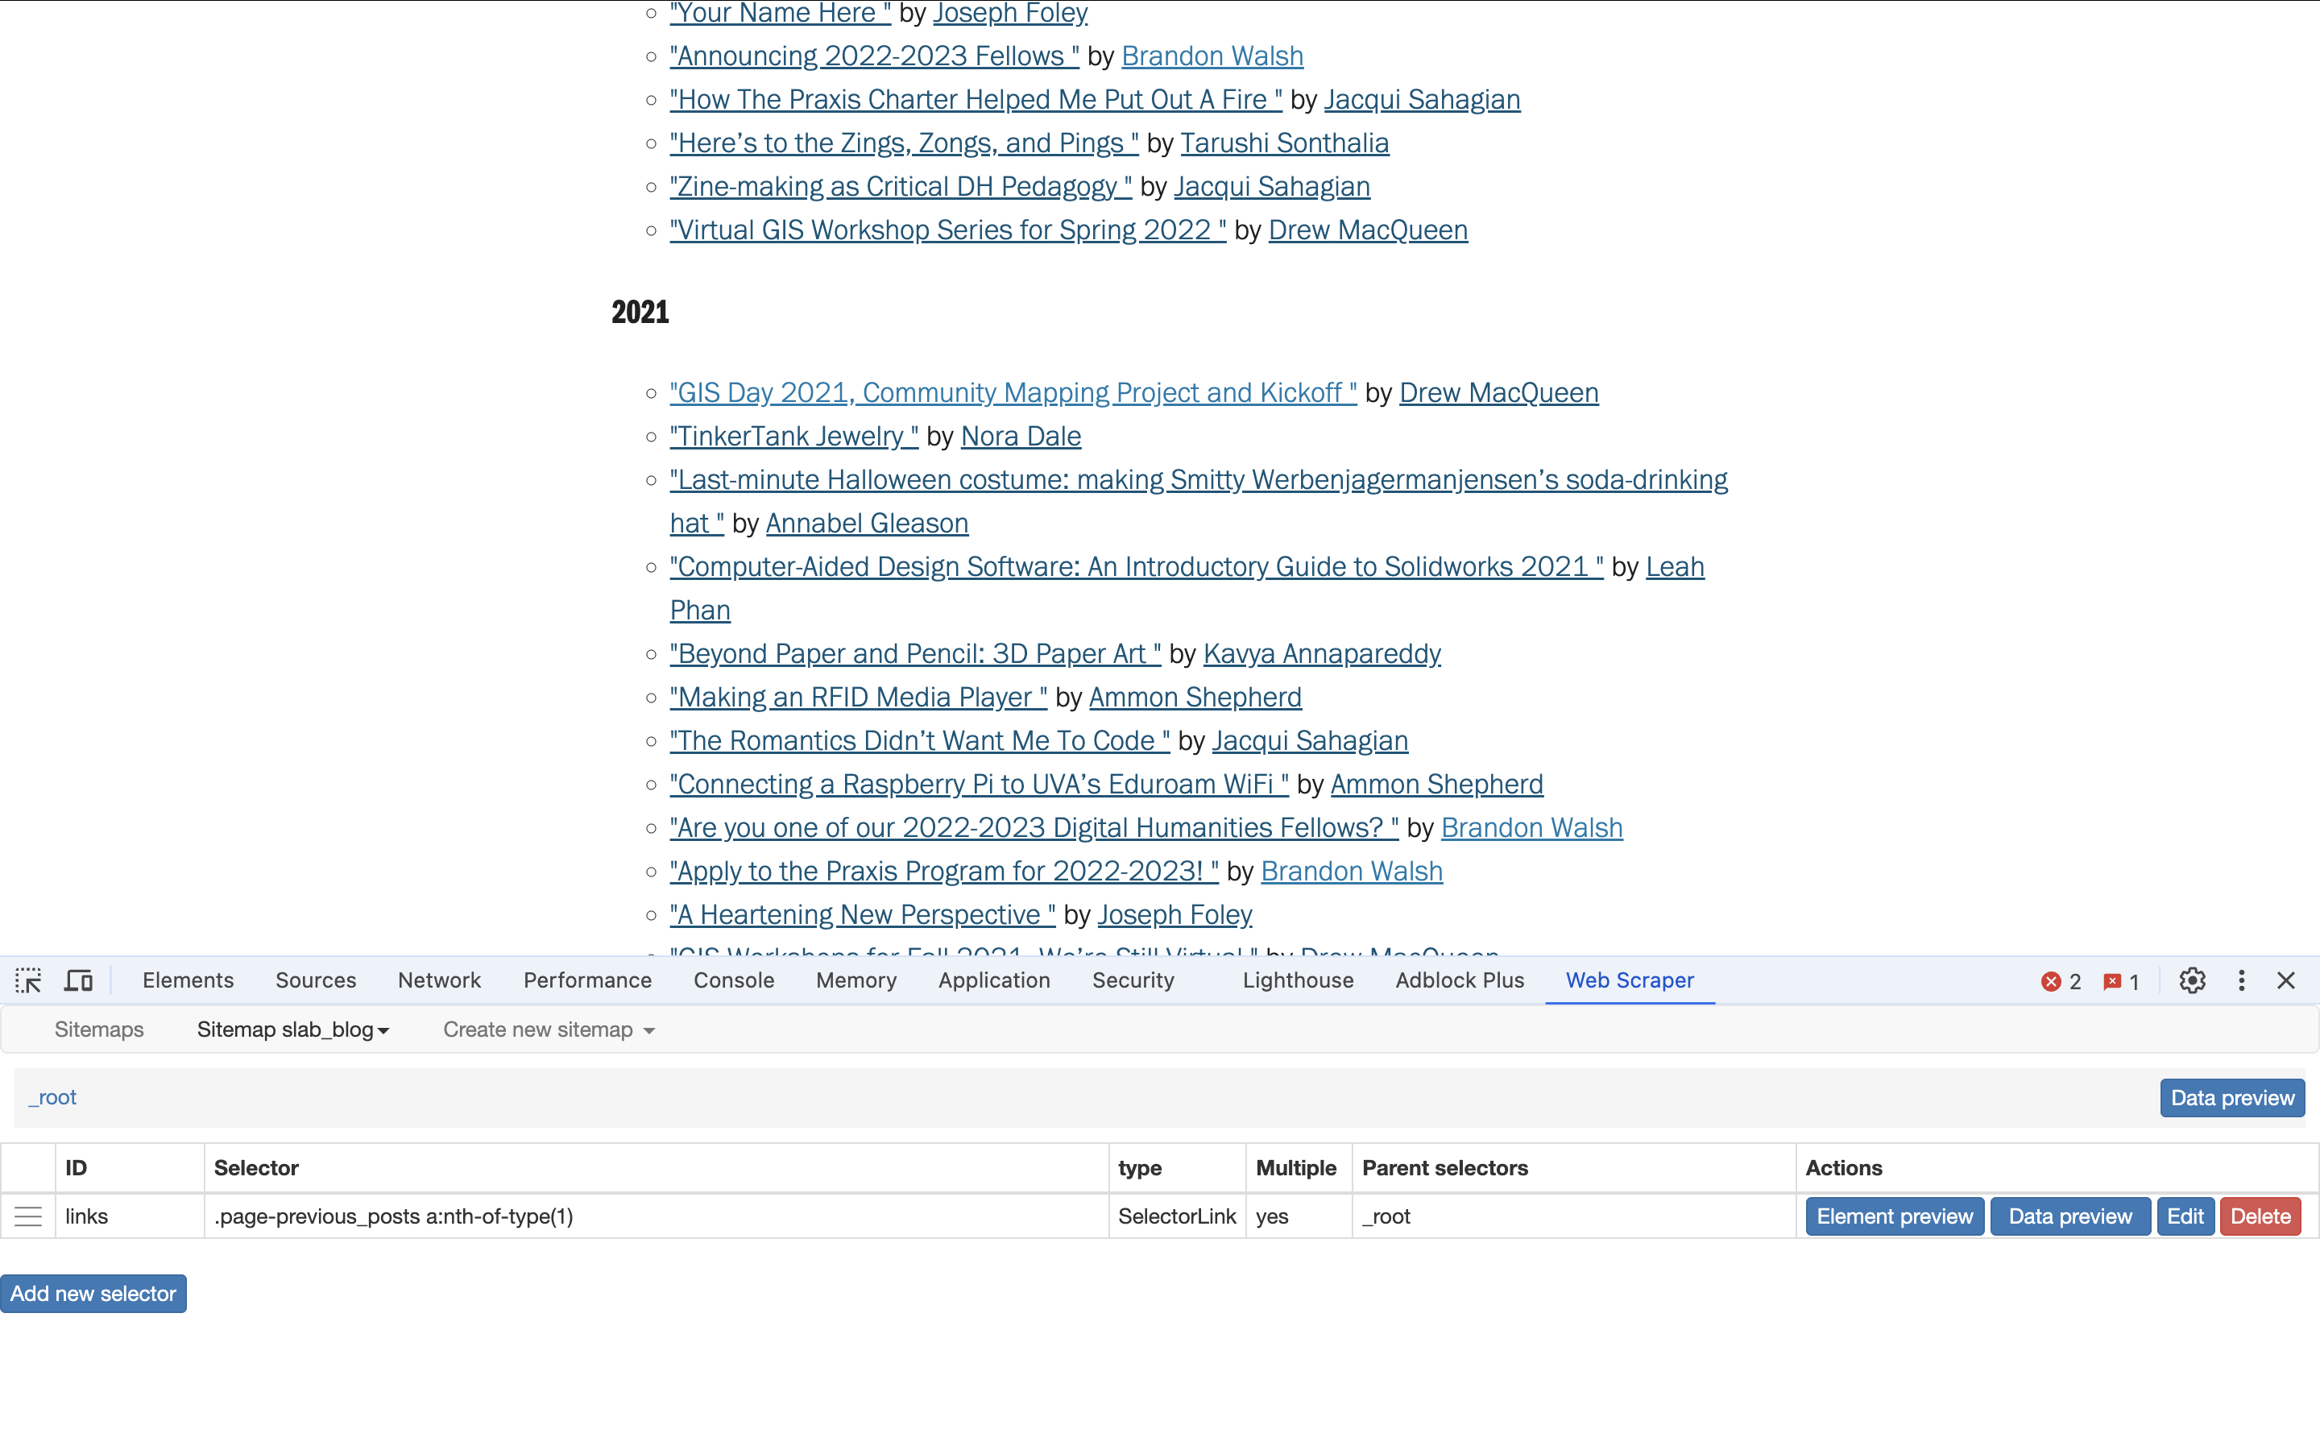
Add a Child Selector
Once we save, we should see our selector.
We can check our work by hitting ”data preview”
That gets all our links, but we want the posts too!
We go through the same process to add a child selector.
Click on the “links” ID to make a child selector by clicking “add new selector”
Notes:
Now show how to click through on all the individual pages and get the specific text for it

Slide 23
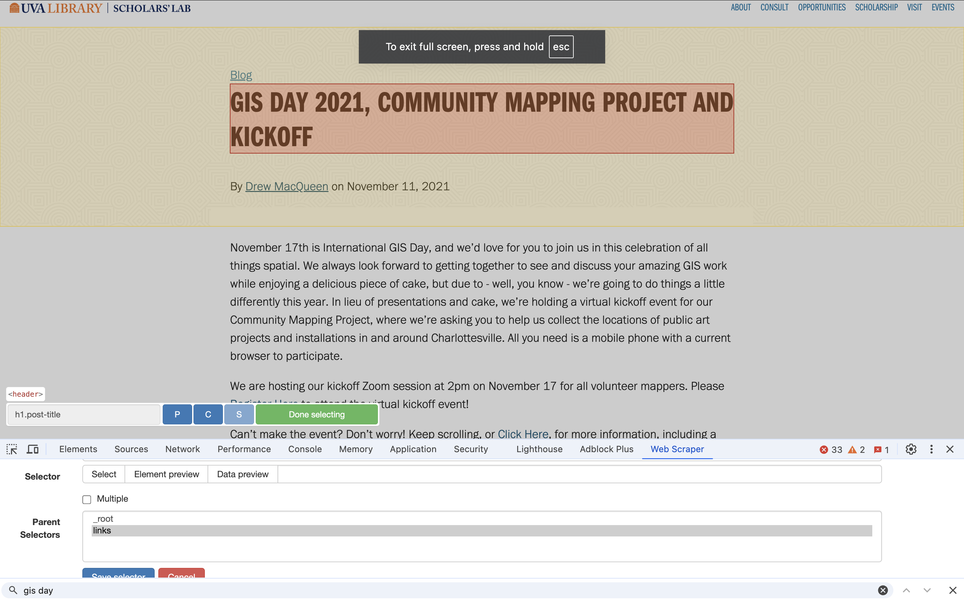
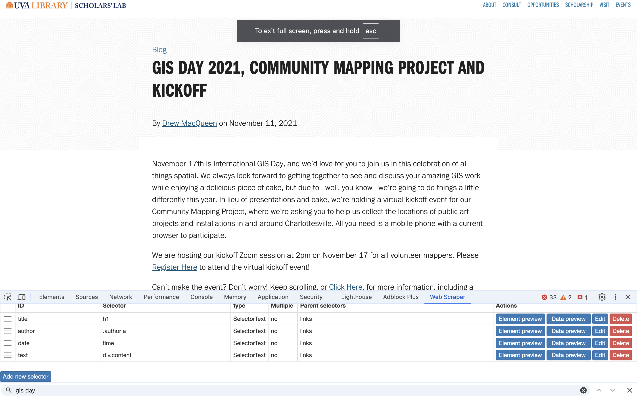
Make our Post Selectors
Once you have hit “add new selector” from within the links selector…
Navigate to a post page
Label this selector ”title”
This time we will use “text” for type.
Use the select process to click on the title.
Make sure the “links” ID is selected as the parent selector.
Save
We have to do this for each piece of the page we want.
Repeat the process for the other pieces of the page. Make a text selector for the title, the author, the date, and the post content
Notes:
Issue rn is that it is rescraping each page for each item in the post selector
export

Slide 24
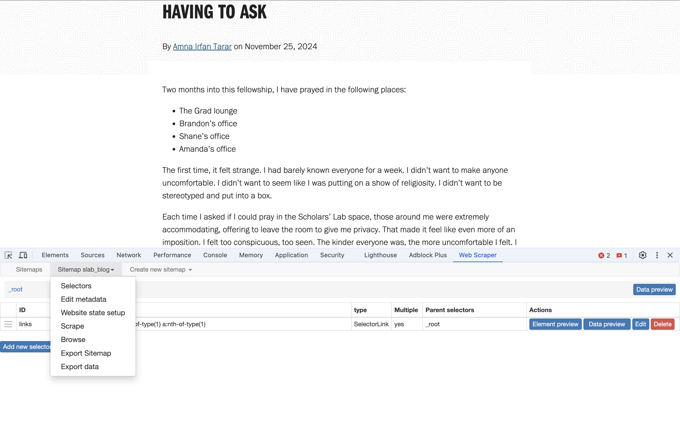
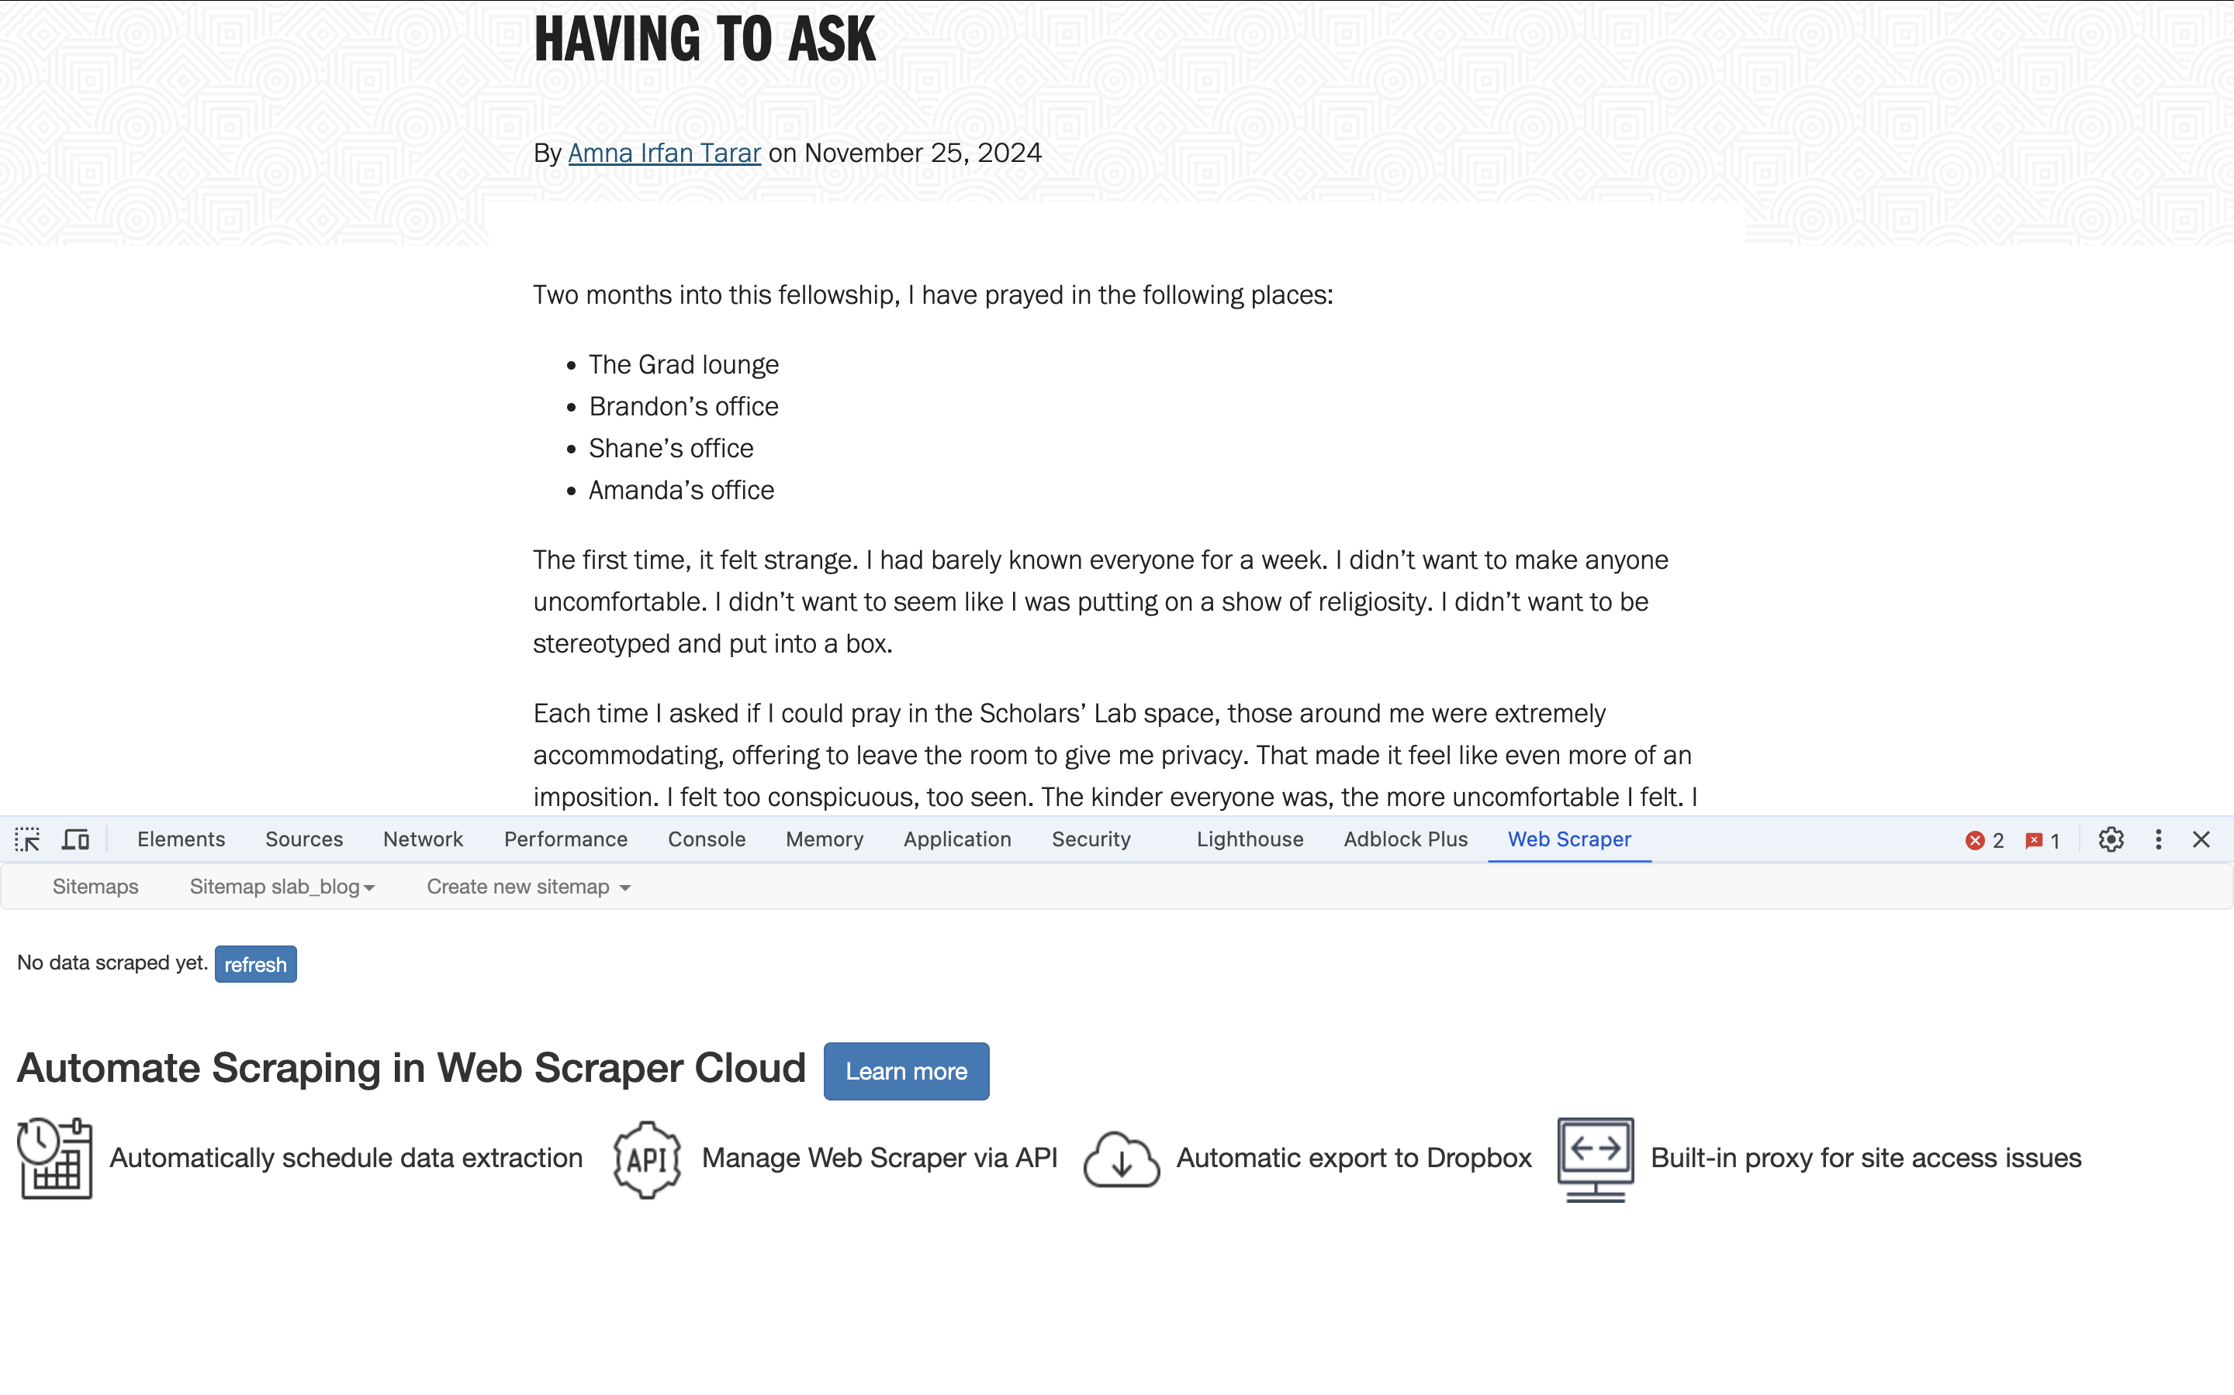
Start the Scrape
Now we’re ready to start.
Click the dropdown at the top with your sitemap title in it and select “scrape”
Why do we think the first options are about delay intervals?
Start your scrape
If all goes well, webscraper will pop open a new window where you will see the system paging through your scrape
You’ll also notice in the original tab that it tells you to refresh to see the data as it comes in.
Notes:
Issue rn is that it is rescraping each page for each item in the post selector
export

Slide 25
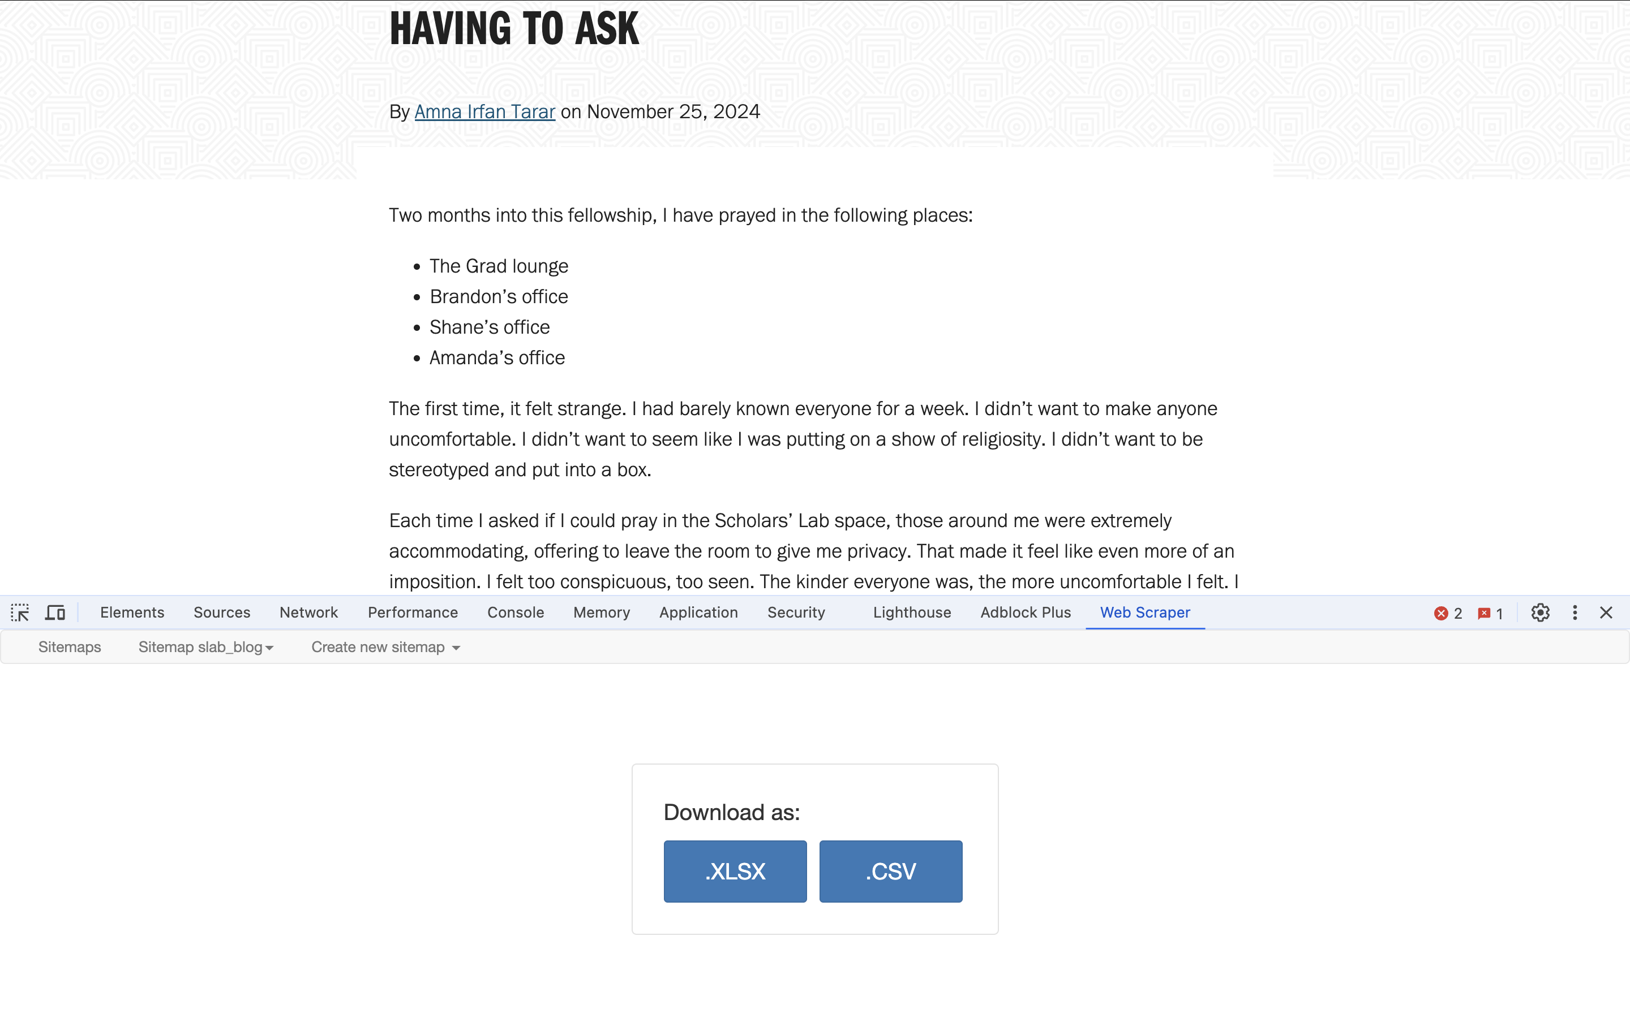
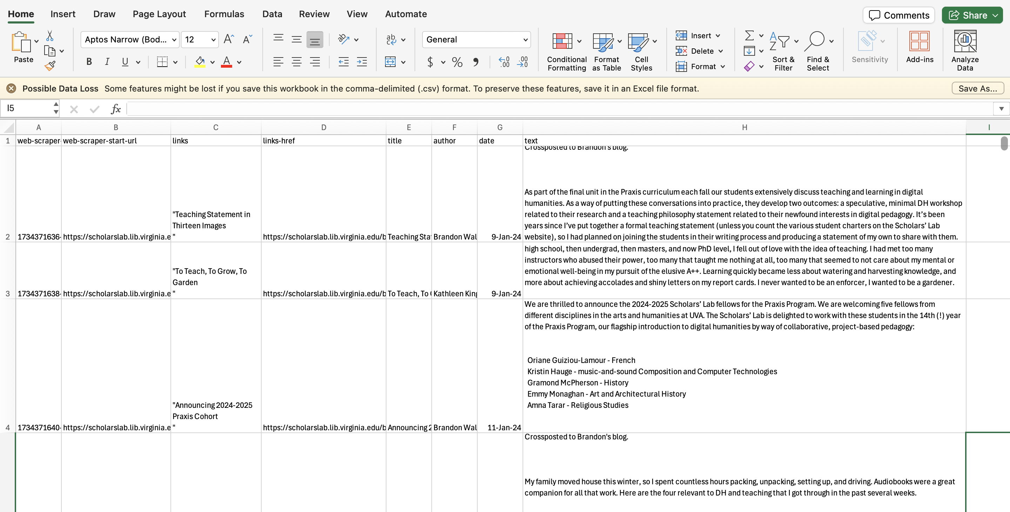
Wrapping Up
This will take quite a while depending on your site.
Have to leave your page and scrape open!
Alas that is why this is free and not paid.
When you’re done, click “Export Data” from the same dropdown and select .CSV
Voila! We have a new dataset.
How does it look? Is there anything we would change?
A preview of next week!

Slide 26
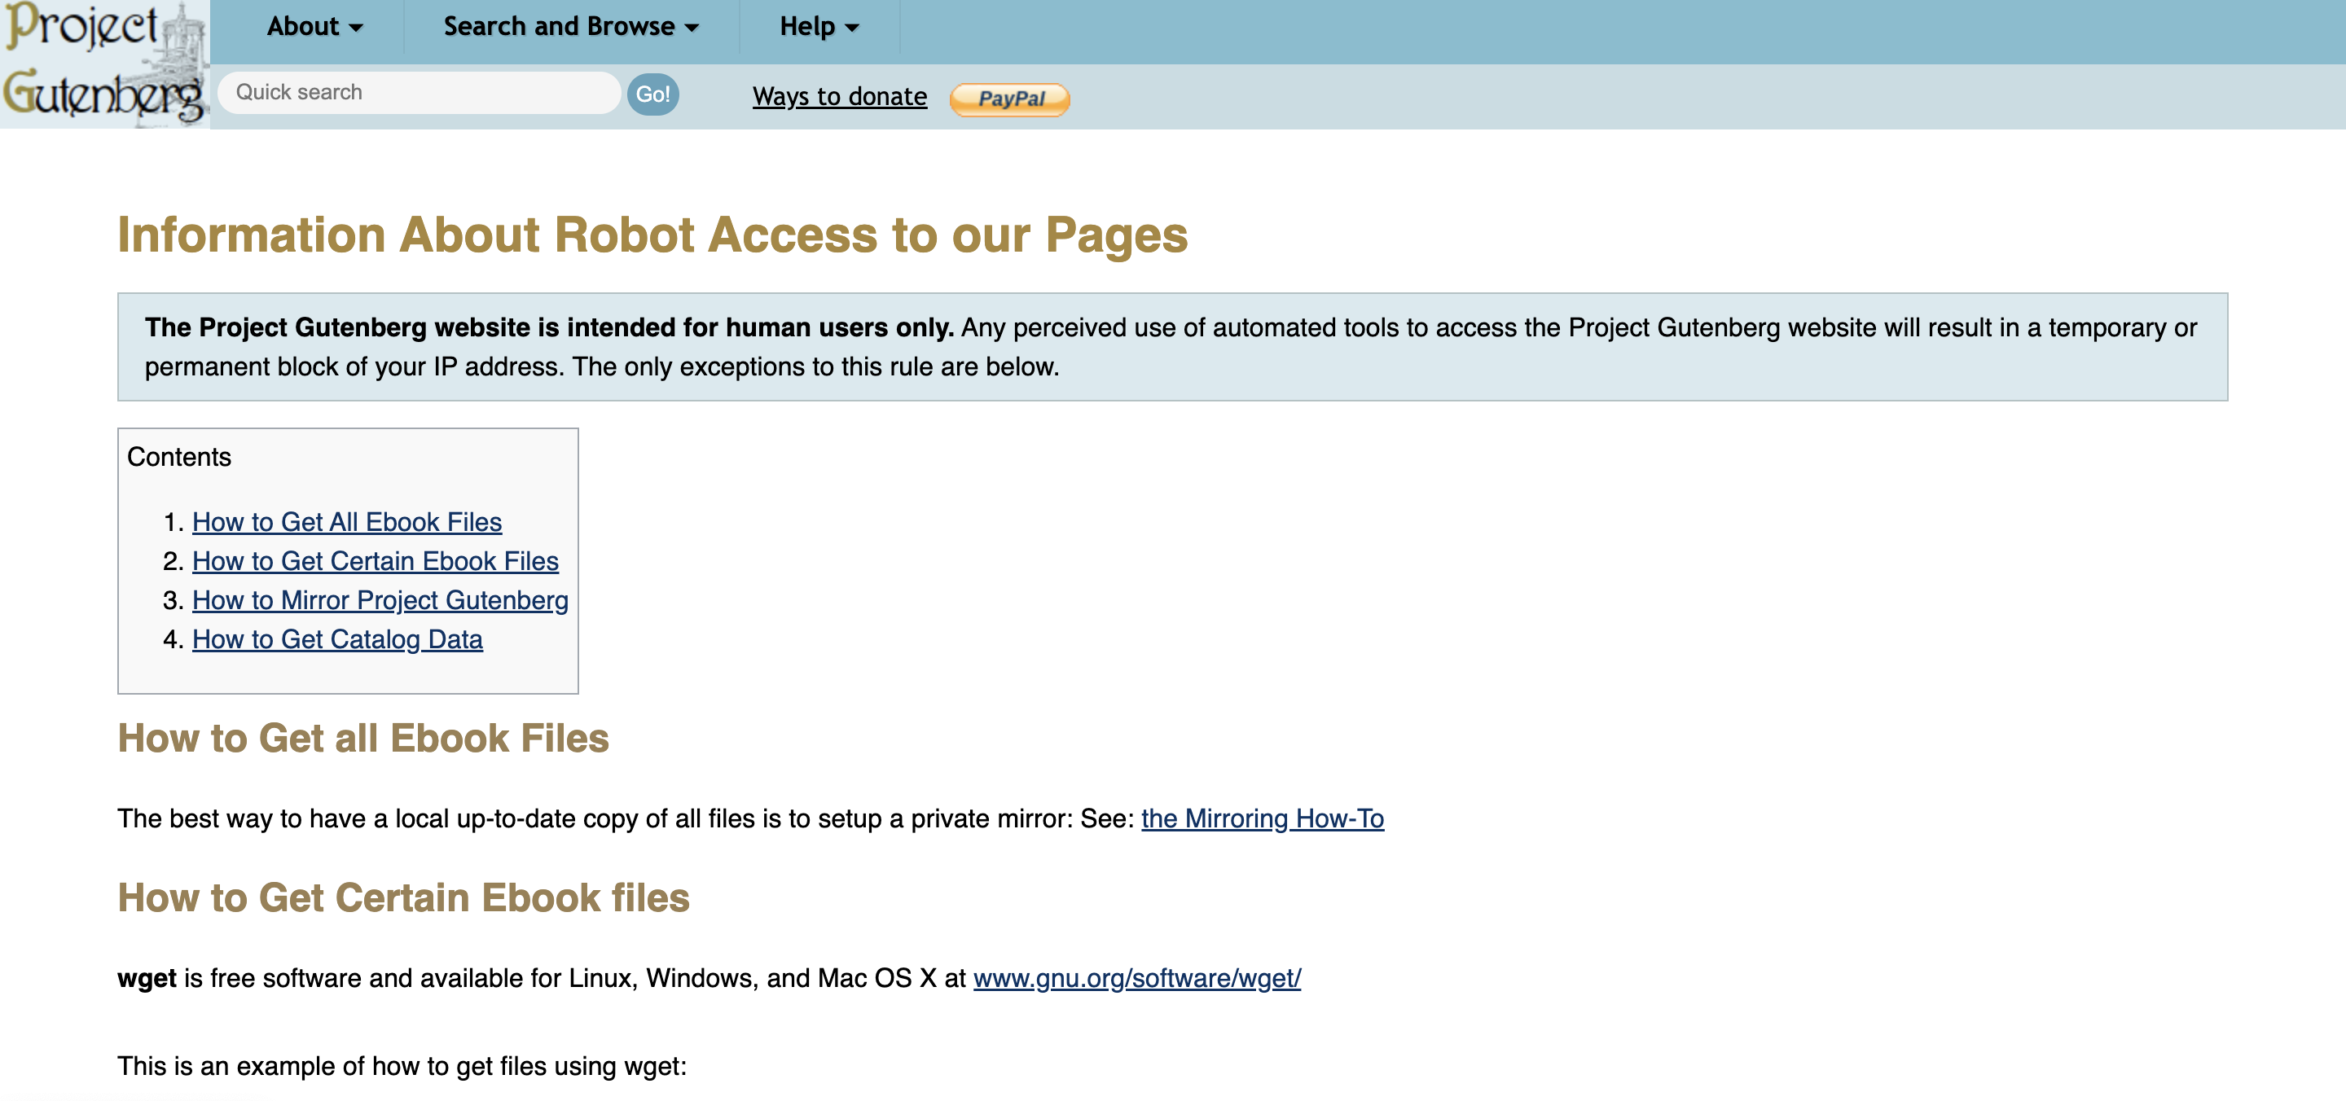
Robots.txt

Slide 27
Time Remaining Practice on Some Other Sites
https://books.toscrape.com/
https://quotes.toscrape.com/
https://webscraper.io/test-sites

Slide 28
Takeaways
LOTS of data out there
Range of ways to gather it
Do so with care
Does your plan pass the smell test? IRB?

Slide 29
Homework
Practice scraping! Use webscraper.io to scrape this simple countries of the world example. By Friday at 9:00 AM, send me a CSV of your results.
Identify three other sites that contain data you might be interested in collecting. Think especially about different kinds of content, especially those related to arts, culture, and the humanities. Share them by Friday at 9:00 AM.

